Slide 1
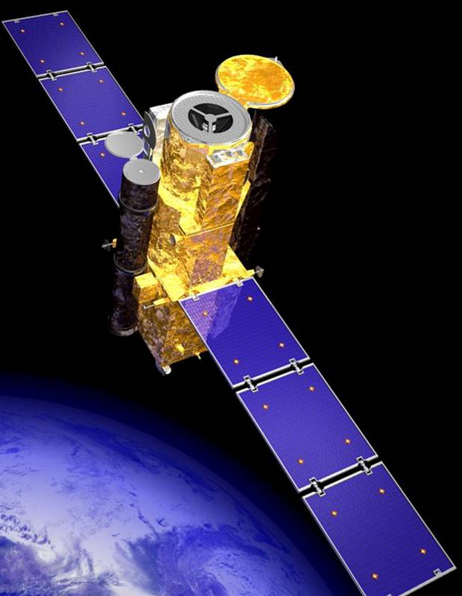
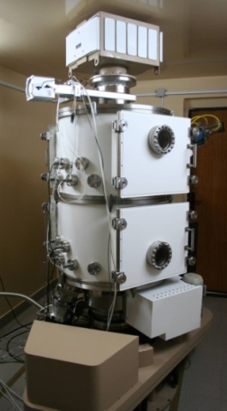
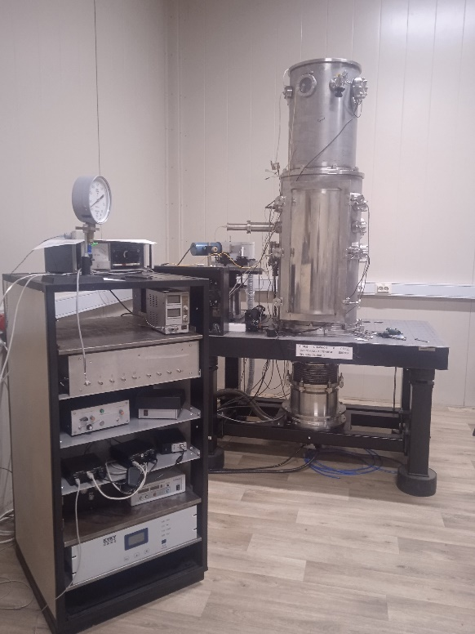
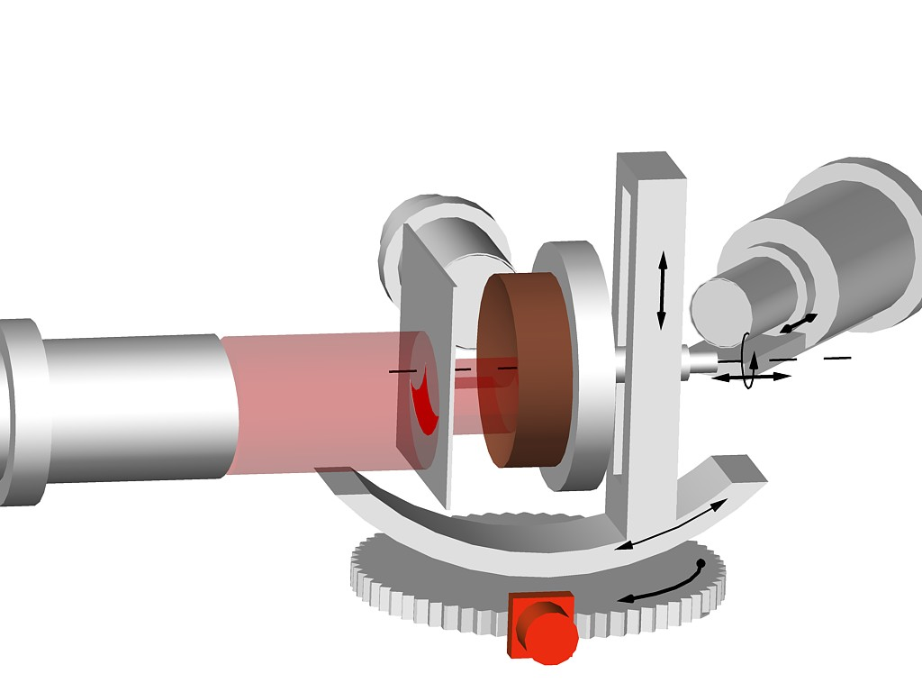
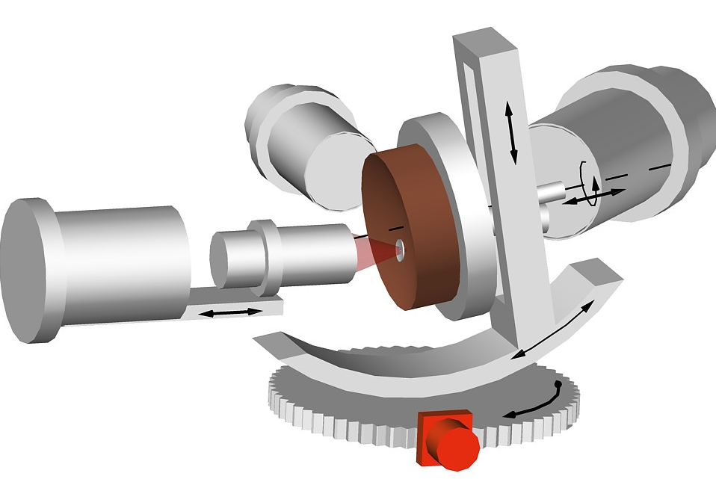
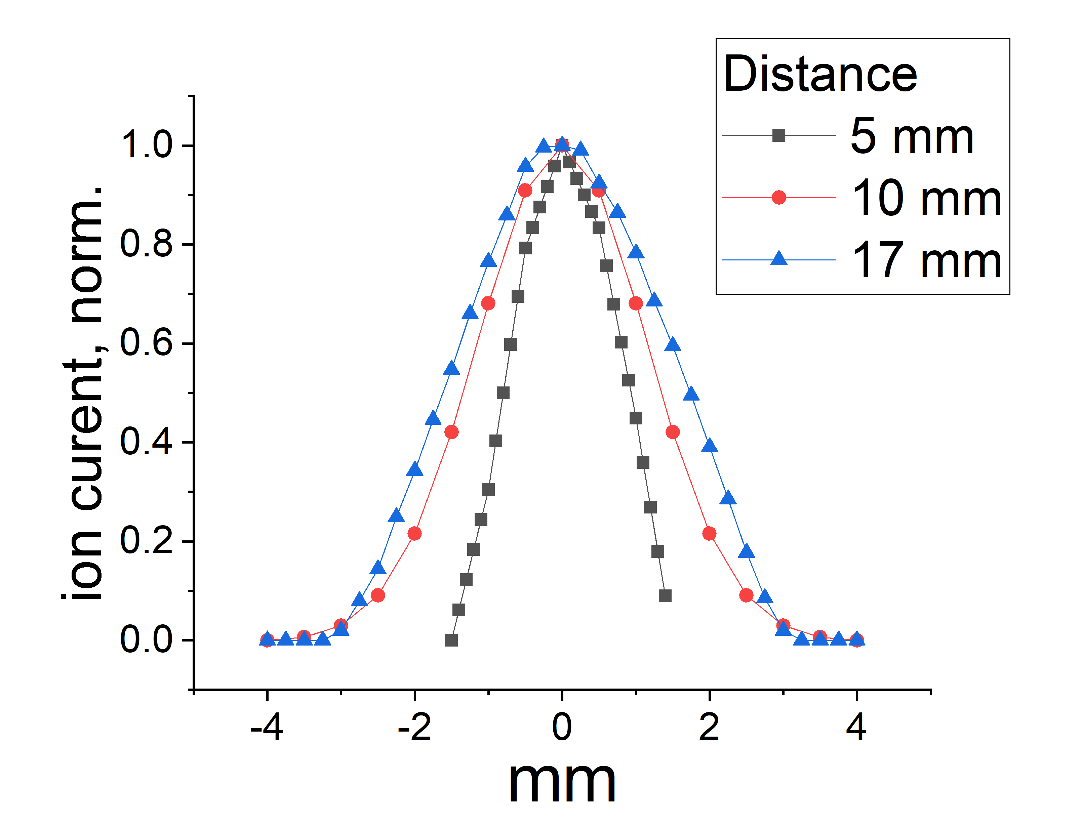
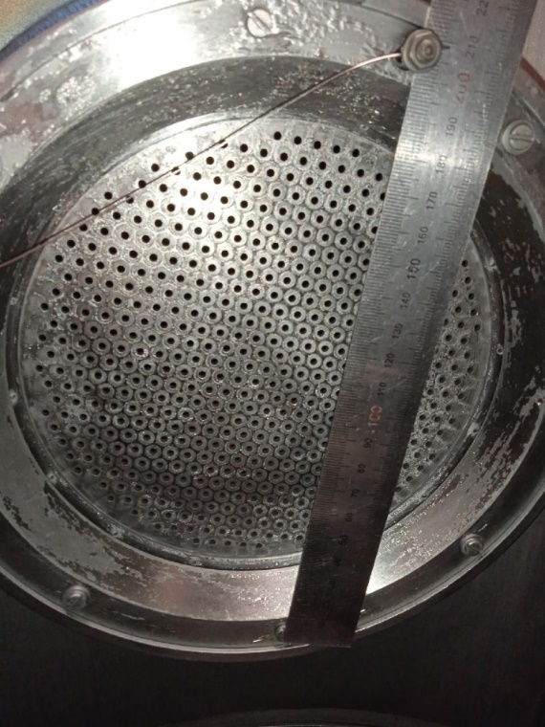
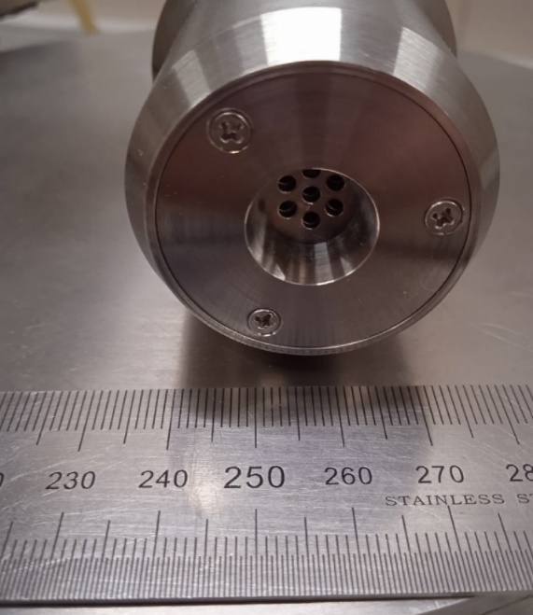
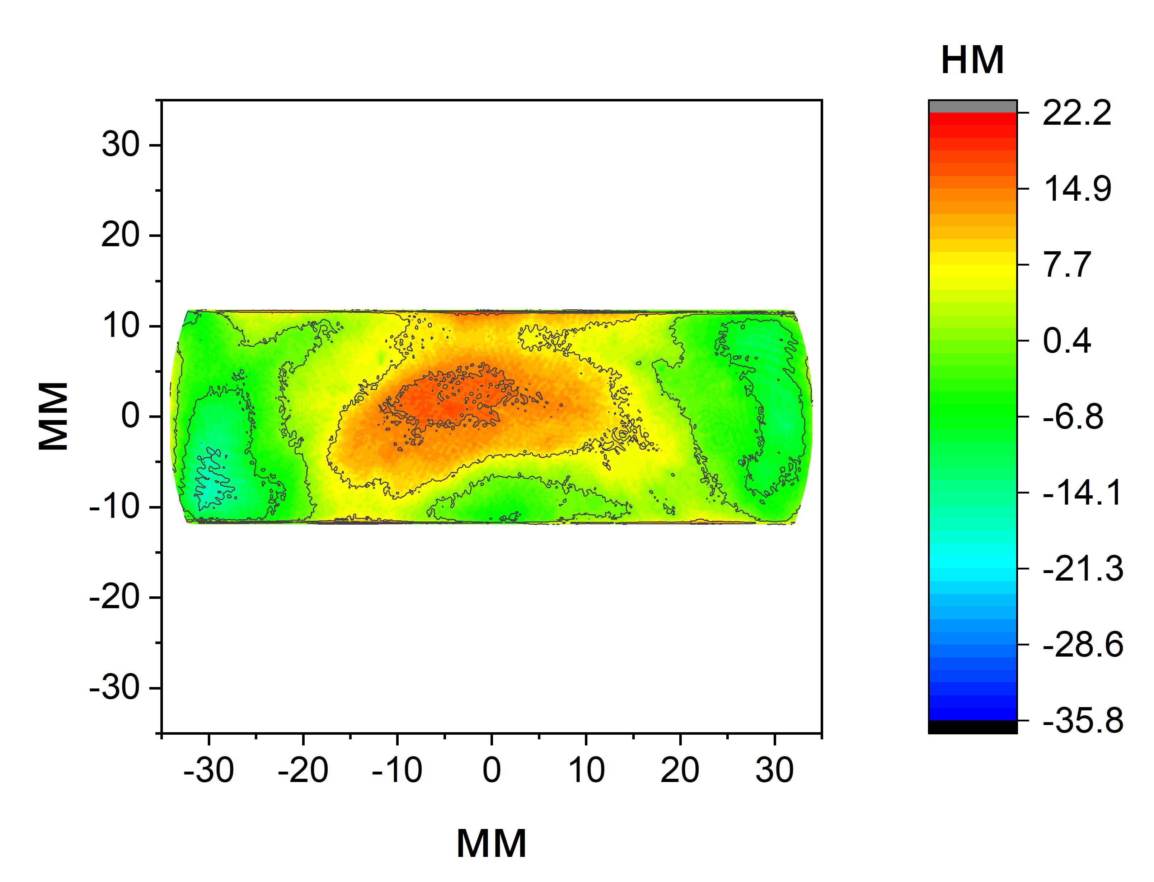
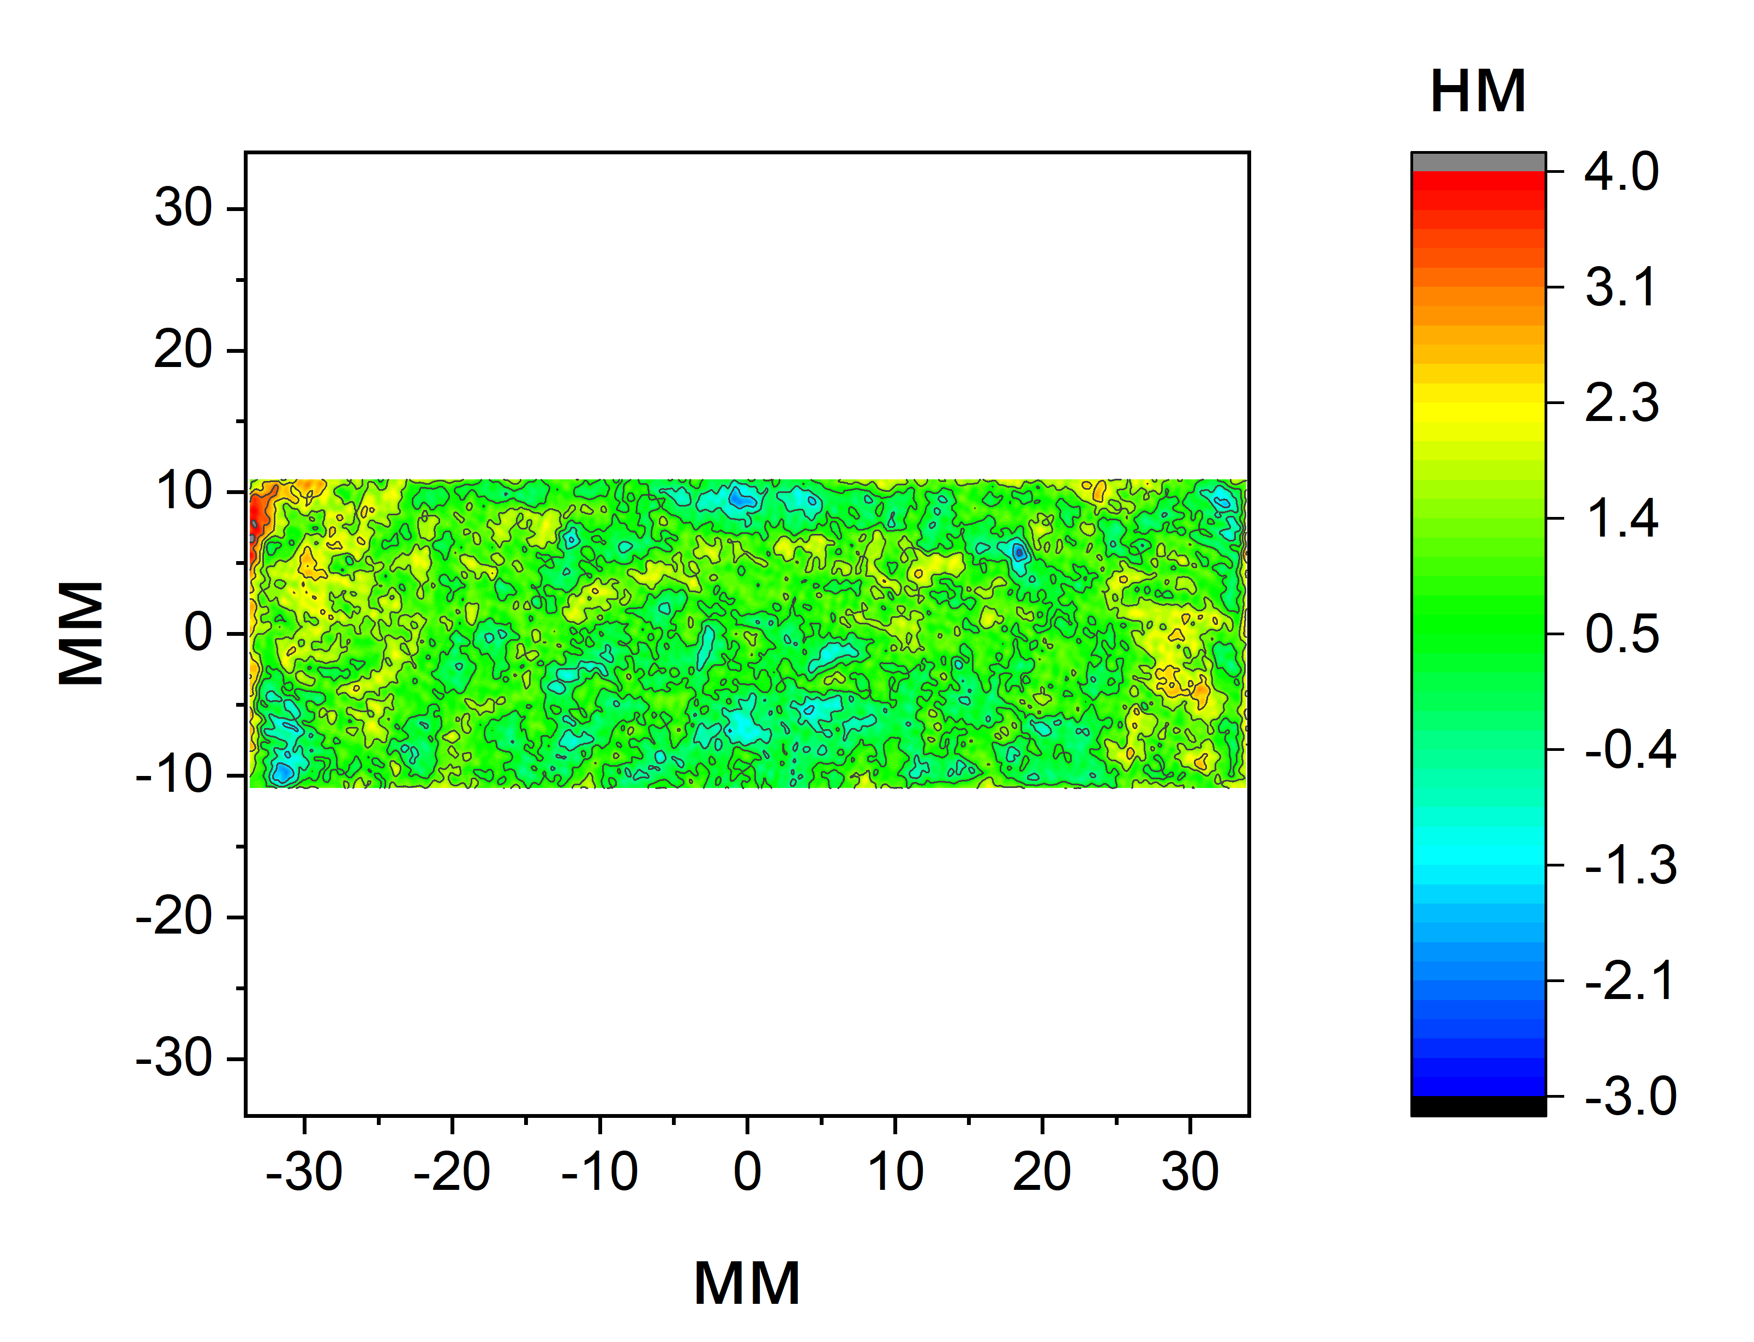
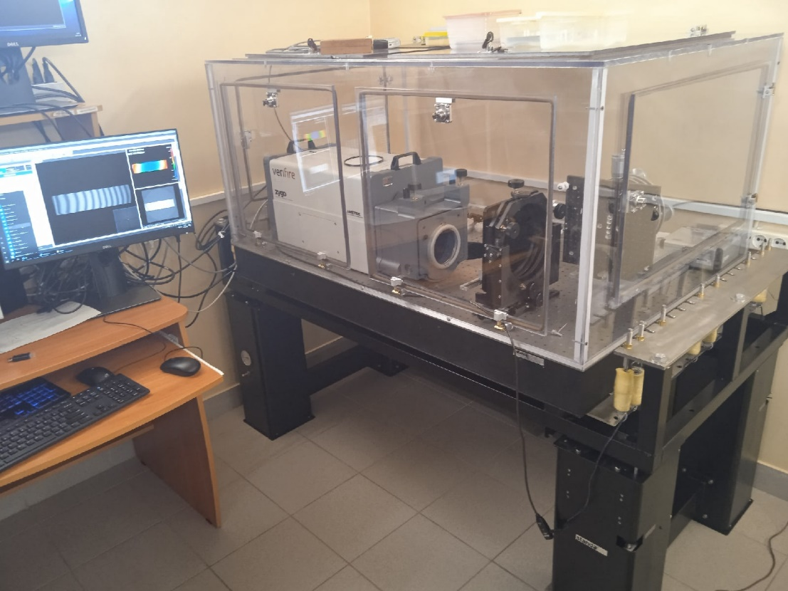
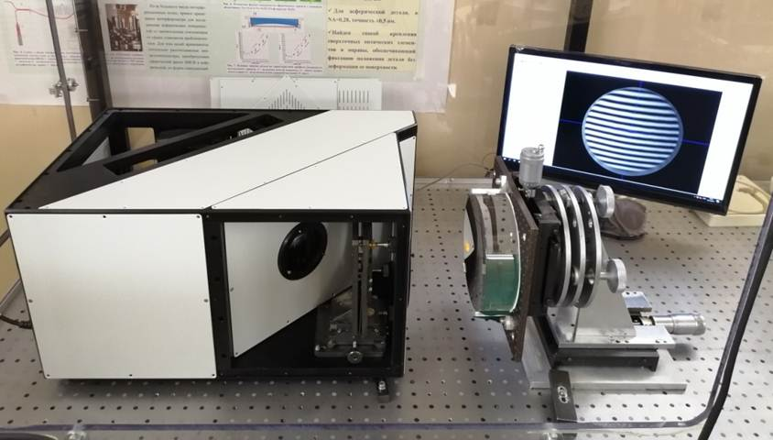
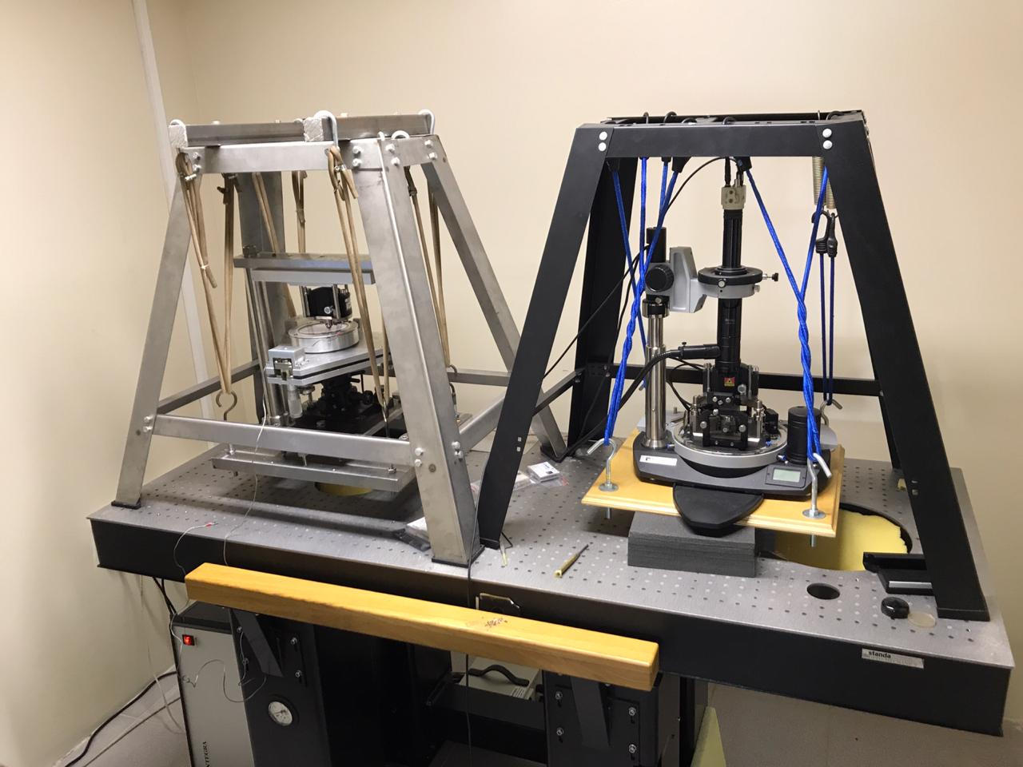
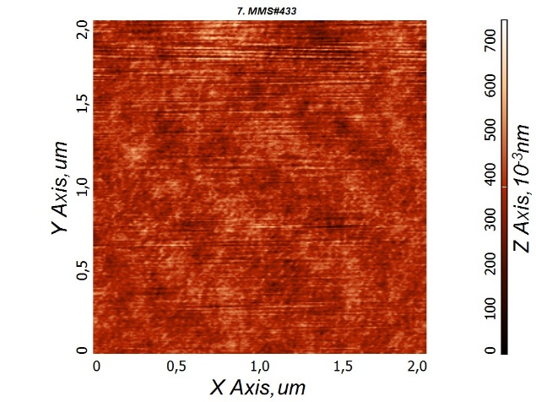
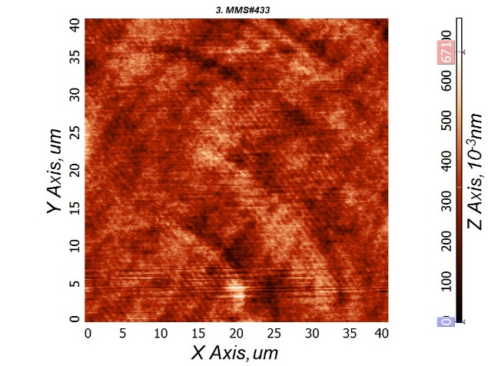
METHODS OF PRECISION ION-BEAM MACHINING
OF OPTICAL SURFACES
А.К. Чернышев¹, М.С. Михайленко¹, А.Е. Пестов¹, Н.Н. Салащенко¹,
Н.И. Чхало¹
¹ Институт физики микроструктур РАН, ул. Академическая, д. 7, Нижний Новгород, 607680.
e-mail: chernyshev@ipmras.ru
ИФМ РАН
Introduction
EUV
astronomy
λ = 17,1 – 58,4 nm
Required accuracy
RMS < 1.2 nm
EUV lithography
λ = 11,2 nm
Required
accuracy
RMS < 0.8 nm
SXR microscopy
λ = 3,14 nm
Required accuracy RMS < 0.2 nm
The mirror surface shape accuracy must obey the Marechal criterion following relationship:
$$RMS ≤ λ/{14}$$
Optical surfaces with the required characteristics can be obtained using ion beam etching
Блок 2а. Локальная коррекция
Axisymmetric surface shape correction^{[1]}
Ion beam figuring (IBF)^{[2]}
Scheme 1. Schematic diagram of the ion beam etching machine for axisymmetric surface treatment:
1 - 5-axis goniometer;
2 - sample;
3 - figured diaphragm;
4 - quasi-parallel ion beam;
5 - wide-aperture ion source. KLAN-163M
Scheme 2. Schematic diagram of the ion beam etching machine for figuring:
1 - 5-axis goniometer;
2 - sample;
3 - focused ion beam;
4 - small-sized ion source
1
2
3
4
4
3
2
1
5
Radiofrequency ion source 13.56 MHz
Aperture ∅ 150mm,
Ion current (max) 400 mA
Material removal rate (max) 3 mkm/h throughout the aperture
Ion source with cold hollow cathode
Aperture ∅ 7 mm,
Ion current density (max) 95 mA/сm²,
Material removal rate (max) 1 mkm/min,
Half-height width d ≈ 2 mm
Ion source
KLAN -163 М
Ion current distribution along the radius of the aperture of the KLAN-163M source. Gas - Ar, I_{ion}=100 mA.
Ion source
KLAN -12 М
Ion current distribution along the radius of the aperture of the KLAN-12M source. Gas - Ar,
I_{ion}=0,3 mA.
Surface map before ion etching
PV = 48 nm
RMS = 9.6 nm
Axisymmetric part of the surface map
PV= 35 nm
RMS = 9.1 nm
Surface map after ion etching
PV = 36 nm
RMS = 3 nm
figured diaphragm
Surface map before IBF
PV = 57.6 нм; RMS = 7.6 нм
Surface map after IBF
PV = 6.8 нм; RMS = 0.72 нм
Metrology
interferometer
Zygo verifire 4
Compact high-aperture interferometer
with a diffractive reference wave ^{[3]}
interferogram and surface map
atomic force microscope (AFM)
Финансирование
Работа выполнена при финансовой поддержке Российского научного фонда (грант №21-72-30029) и с использованием оборудования ЦКП «Физика и технологии микро- и наноструктур» при ИФМ РАН.
Литература
N.I. Chkhalo, et al. // Prec. Engineering. 2017. V.48. 338-346.
A. Chernyshev, et al. // Precision Engineering, 2021, V.69, P. 29-35
A.A. Akhsakhalyan, et al. // Prec. Engineering. 2021. V.72. 330-339.

