Slide 1

Plasma-assisted chemical vapor deposition of a-C:H:SiO_{x} coatings. Surface modification of VT6 titanium alloy.
ISI–2021
The XXV International Conference
on Ion-Surface Interactions
A.S. Grenadyorov¹, А.А. Solovyev¹, K.V. Oskomov¹, V.A. Semenov¹, S.V. Rabotkin¹, M.O. Zhulkov^{1,2}, A.M. Chernyavskiy², D.A. Sirota^{1,2}, N.A. Karmadonova³, V.V. Malashchenko^{1,3}, L.S. Litvinova³, O.G. Khaziakhmatova³, N.D. Gazatova³, I.A. Khlusov^{3,4}
¹Institute of High Current Electronics SB RAS, Tomsk; ²Meshalkin National Medical Research Center, Novosibirsk; ³Immanuel Kant Baltic Federal University, Kaliningrad; ⁴Siberian State Medical University, Tomsk. Tomsk – 2021

Slide 2
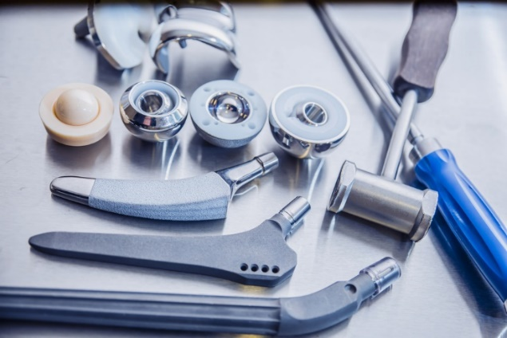
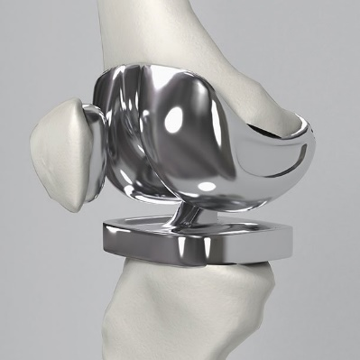
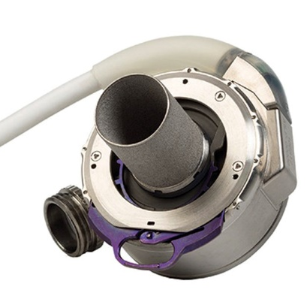
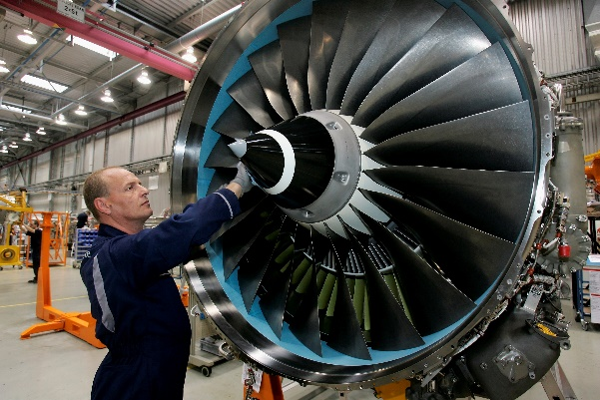
Problem
Titanium materials
(Grade 2, Ti-6Al-4V, Ti-6Al-7Nb et al.)
Disadvantages:
Low wear resistance,
Insufficient biocompatibility.

Slide 3
Solution
Biological environment
Biochemical reactions^{1,2}
Surface layer
Material volume
a-C:H:SiO_{x} films
High mechanical properties;
Corrosion and wear resistance;
High biocompatibility;
Inactivity to the biological environment of a person³⁻⁵.
Ссылки:
[1] Handbook of Antimicrobial Coatings. Editors: A.Tiwari, A. Chaturvedi. Elsevier. – 2018. – P. 596.
[2] Surgical Tools and Medical Devices. Second Edition. Editors: Waqar Ahmed, Mark J. Jackson. Springer International Publishing Switzerland. – 2016. – P. 691.
[3] Surgical Tools and Medical Devices. Second Edition. Editors: Waqar Ahmed, Mark J. Jackson. Springer International Publishing Switzerland, 2016. – P. 691.
[4] Meskinis S. and Tamuleviciene A. / Structure, Properties and Applications of Diamond Like Nanocomposite (SiO_{x} Containing DLC) Films: A Review // Materials science. – 2011. – V. 17. – №4. – P. 358-370.
[5] Feng Wen, Jiaqi Liu, Jianlu Xue / The Studies of Diamond-Like Carbon Films as Biomaterials: Review // Colloid and Surface Science. – 2017. – V. 2. – P. 81-95.

Slide 4
Aim of work
The purpose of the work was to modify the surface of the VT6 titanium alloy by a-C:H:SiO_{x} films, characterized by high mechanical, tribological, anticorrosive and biomedical properties.
Tasks:
To obtain a series of samples with a-C:H:SiO_{x} film;
To investigate the tribological and mechanical properties of the obtained samples;
To investigate the corrosion resistance in solutions of 0.5M NaCl and PBS;
To investigate the cytotoxicity of a-C:H:SiO_{x} film in relation to human blood leukocytes;
To investigate the proinflammatory response of a-C:H:SiO_{x} films to cytokines and chemokines.

Slide 5
Analytical Instruments
Nanoindenter (Nanotest 600, GB);
Tribotester (Pin on the Disc and Oscillating TRIBOtester, France);
Potentiostat-galvanostat P-45X (Electrochemical Instruments, Russia);
Continuous-flow fluorimetry (MACS Quant FL7, Germany);
Flow Analyzer (Bio-Plex Protein Assay System, USA).

Slide 6
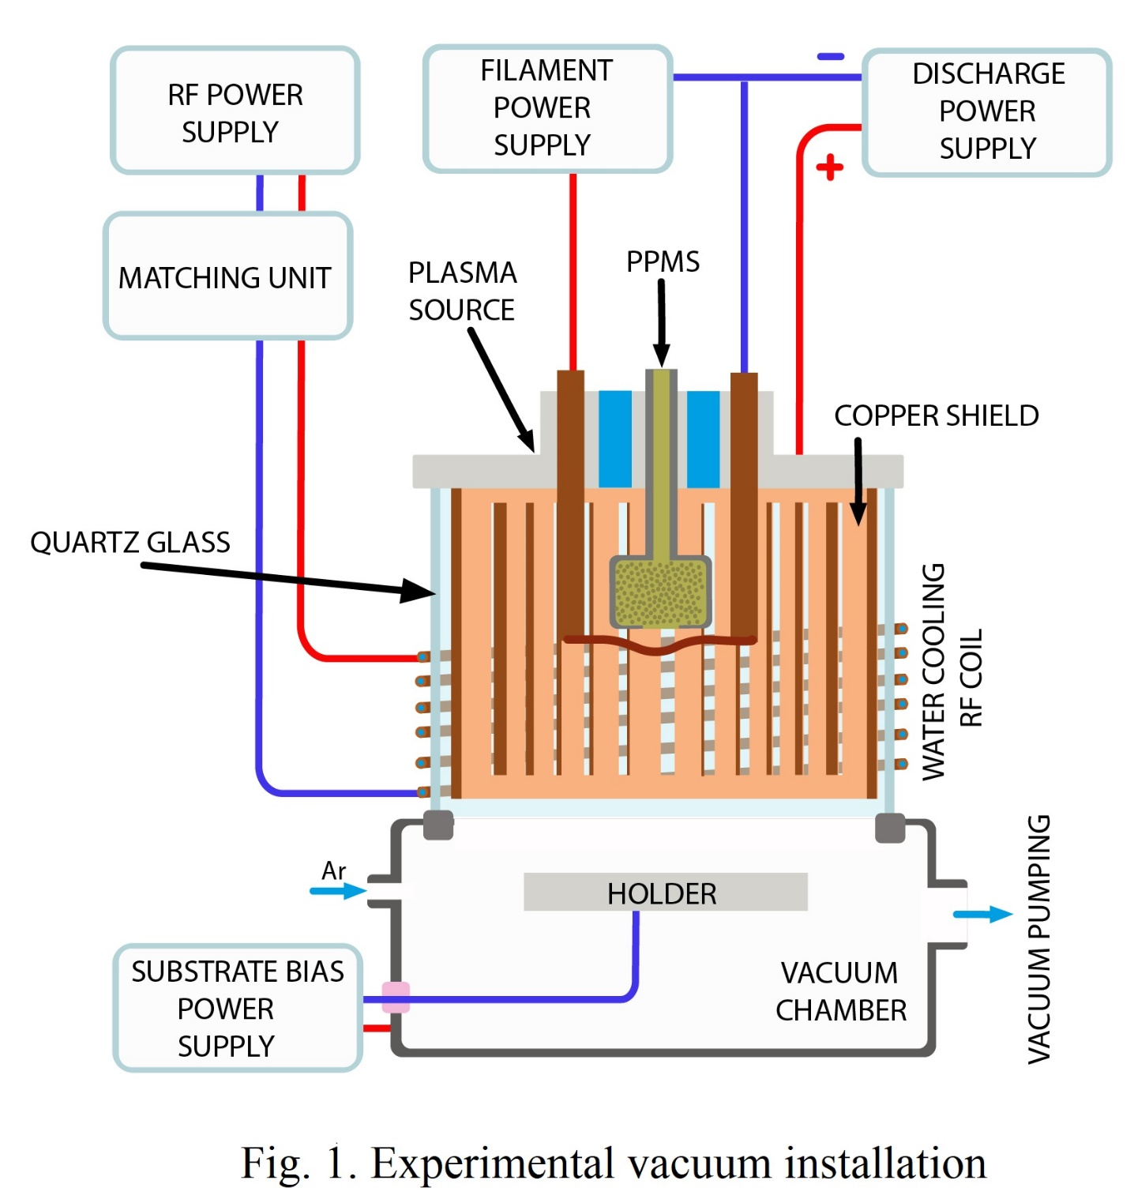
Experimental Vacuum Installation

Slide 7
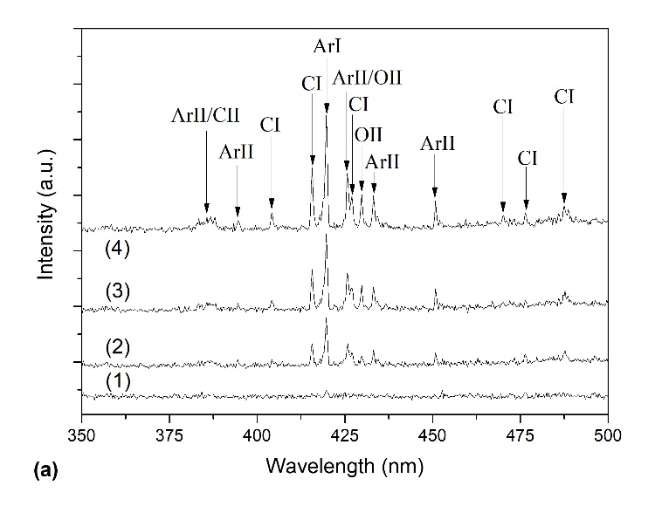
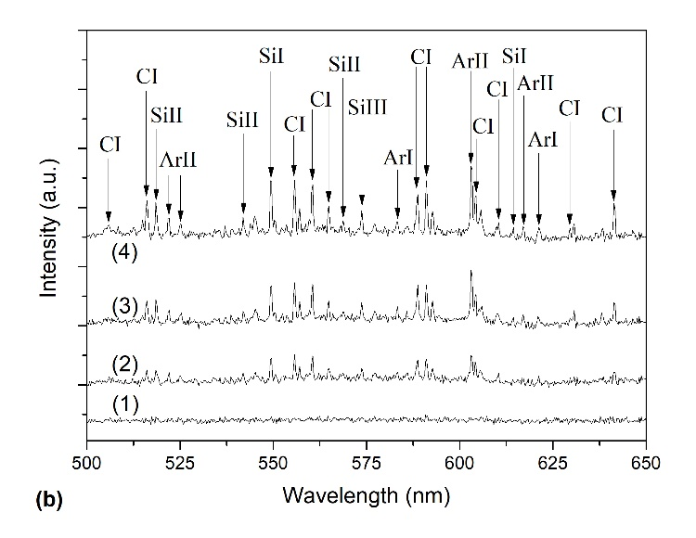
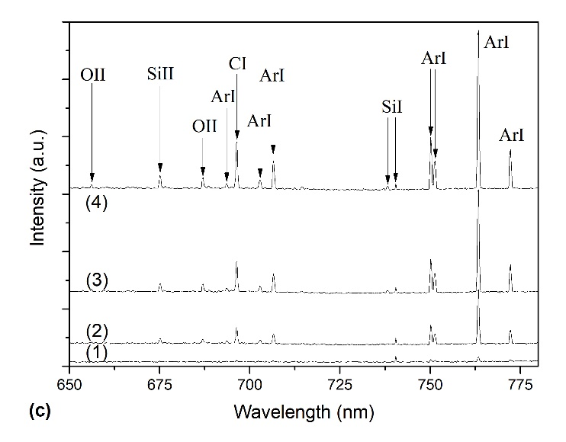
Results of Optical Emission Spectrometry of the Discharge
Optical emission spectra of Ar/PPMS mixture plasma in 350–500 nm (a), 500–650 nm (b), 650–800 nm wavelength range at different values of discharge power: (1) – 0 W, (2) – 100 W, (3) –200 W, (4) – 300 W.

Slide 8
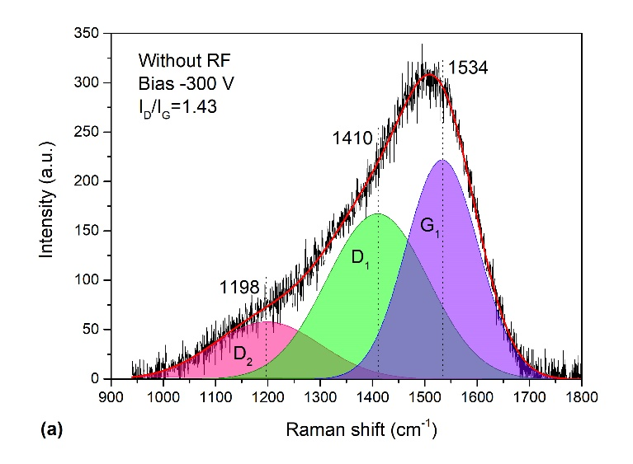
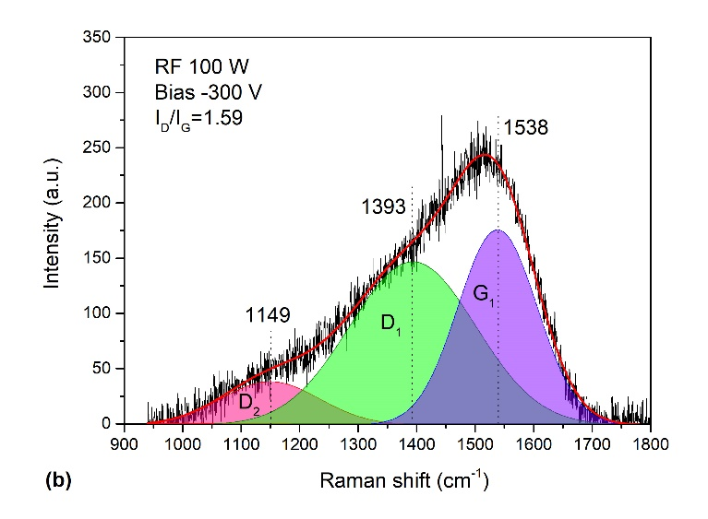
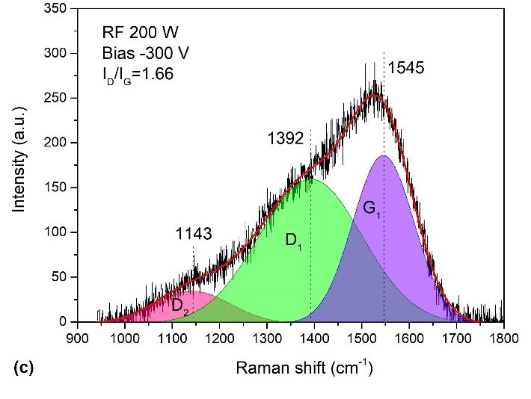
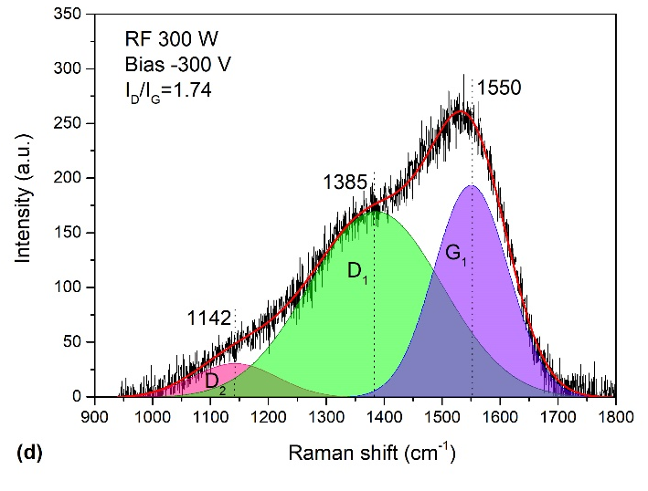
Results of Raman Spectroscopy
Raman spectra of a-C:H:SiO_{x} coatings deposited at different RF discharge power and –300 V substrate bias voltage:
a – 0 W, b – 100 W, c – 200 W, d – 300 W.

Slide 9
Results of EDX Analysis, Mechanical and Tribological Properties
Table 1. Elemental analysis (EDX) of a-C:H:SiO_{x} coatings (Bias -300 V)
P_{RF}, W | j_{i}, mA/cm² | C, at.% | Si, at.% | C/Si
- | 0.26±0.02 | 86.0±0.15 | 14.0±0.14 | 6.1
100 | 0.40±0.03 | 87.5±0.10 | 12.5±0.11 | 7.0
200 | 0.65±0.05 | 88.8±0.23 | 11.2±0.28 | 7.9
300 | 0.90±0.06 | 90.1±0.15 | 9.9±0.12 | 9.1
Table 2. Mechanical and tribological properties of a-C:H:SiO_{x} coatings (Bias -300 V)
P_{RF}, W | H, GPa | H/E | H³/E², MPa | W, mm³/N·m
0 | 14.3±0.05 | 0.118±0.01 | 199±2 | 5.80·10⁻⁷±1.34·10⁻⁷
100 | 16.5±0.08 | 0.122±0.01 | 249±2 | 4.66·10⁻⁷±1.74·10⁻⁷
200 | 16.1±0.26 | 0.121±0.02 | 238±10 | 3.83·10⁻⁷±1.43·10⁻⁷
300 | 16.4±0.13 | 0.126±0.01 | 260±5 | 2.74·10⁻⁷±1.24·10⁻⁷

Slide 10
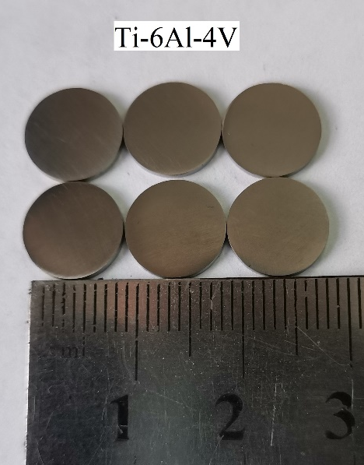
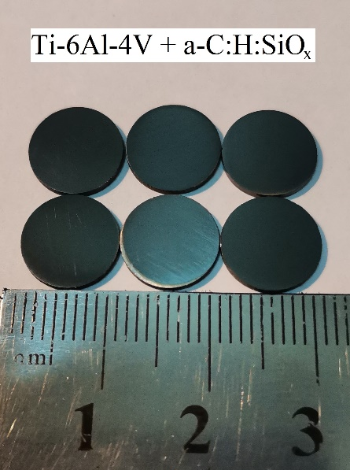
Results of Mechanical and Tribological Tests
Table 3. Mechanical and tribological properties of a-C:H:SiO_{x} films (P_{RF}=300 W, Bias -130 V)
Substrate groups | H (GPa) | H/E | H³/E² (MPa) | µ | W (mm³/N·m)
Ti-6Al-4V | 3±0.1 | 0.03±0.01 | 3±0.8 | 0.63±0.05 | 6.5·10⁻⁴±2.5·10⁻⁵
Ti-6Al-4V + a-C:H:SiO_{x} | 16±0.2 | 0.13±0.01 | 258±6 | 0.08±0.01 | 4.1×10⁻⁷±5.9×10⁻⁸
Notation: H – hardness, H/E – plasticity index,
H³/E² – resistance to plastic deformation, µ – coefficient friction,
W – wear rate. The films thickness was 1.5 microns.
Mechanical test: Oliver and Pharr method at load 20 mN. Each specimen was indented 20 times, and the obtained results were averaged.
Tribological test (ball-on-disk configuration): 25 mm/s sliding speed, ZrO₂ ball of diameter 6 mm used as a counter body,
2.9 mm wear scar, 3 N indentation load resulting in a maximum Hertzian contact pressure of 0.8 GPa, and
500 m sliding distance.
The deposition of a-C:H:SiO_{x} coating improves the mechanical properties, reduces the coefficient of friction and the wear rate.

Slide 11
Results of Corrosion Tests
Table 4. The results of corrosion tests of obtained samples
Substrate groups | j_{corr} (mA/cm²) | CR (mm/year)* | E_{corr} (mV)
0.5M NaCl solution at 22±2ºC
Ti-6Al-4V (T₁) | 1·10⁻⁸ | 8.7·10⁻⁵ | -240
Ti-6Al-4V+a-C:H:SiO_{x} (T₂) | 2·10⁻¹⁰ | 15·10⁻⁷ | 80
PBS solution at 37±3ºC
Ti-6Al-4V (T₁) | 3·10⁻⁸ | 2.6·10⁻⁴ | -288
Ti-6Al-4V+a-C:H:SiO_{x} (T₂) | 5·10⁻⁹ | 4.1·10⁻⁵ | 562
Notation: j_{corr} – corrosion current density, CR – corrosion rate, E_{corr} – corrosion potential.
Corrosion tests: three-electrode measuring setup with P-45X potentiostat/galvanostat (Electrochemical Instruments, Russia); a 0.5 M NaCl solution at 22±2°C and a phosphate-buffered saline (8 g NaCl, 0.2 g KCl,
1.44 g Na₂HPO₄, 0.24 g KH₂PO₄) at 37±3°C were used as an electrolyte.
*ASTM, G102-89(2004), Standard Practice for Calculation of Corrosion Rates and Related Information From Electrochemical Measurements, ASTM International, West Con-shohocken, PA, 2004.
The deposition of a-C:H:SiO_{x} coating gives the surface anti-corrosion properties.

Slide 12
Results of cytotoxicity of the obtained samples
Table 5. Results of cytotoxicity of the obtained samples
Sample | Number of cells, %
 | live | dead
Control | 91.3 | 8.7
Ti-6Al-4V | 91.2 | 8.8
Ti-6Al-4V coated by a-C:H:SiO_{x} film | 90.8 | 9.2
Viable cells amount to over 90%. The obtained results satisfy ISO 10993-5-2009 and prove the absence of a-C:H:SiO_{x} film cytotoxicity for human blood mononuclear leukocytes.
The results were obtained at the Immanuel Kant Baltic Federal University (Kaliningrad).

Slide 13
In vitro determination of cytokine and chemokine secretions
Table 6. Concentration (pg/ml) of pro-inflammatory cytokines in intercellular fluid at in vitro mononuclear leukocytes (MNL) contact with the titanium Ti-6Al-4V and
Ti-6Al-4V coated by a-C:H:SiO_{x} film for 24 h.
Test groups, n=5 | Surface potential, mV | Contact angle, deg. | Cytokines |  | Chemokines
 |  |  | IL-17 | TNF-a | IL-8 | RANTES | MCP-1 (MCAF)
C | - | - | 9 (5-17) | 39 (33-69) | 1436 (1055-1725) | 1035 (636-1166) | 164 (162-167)
T₁ | 18±10 | 97±5.1 | 21* (18-22) | 209* (183-311) | 1395* (1242-1570) | 433* (363-659) | 1445* (1324-1570)
T₂ | -27±15 | 104±0.5 | 13** (4-18) | 159** (31-230) | 1457** (1064-2514) | 707** (427-956) | 329** (162-370)
T₃ | -65±25 | 101±1.5 | 10** (10-27) | 80** (76-87) | 1043** (737-1549) | 377** (287-691) | 188** (80-196)
T₄ | -200±50 | 77±1.9 | 12** (9-18) | 58** (34-81) | 803** (591-1152) | 220** (170-598) | 168** (125-177)
Notes: C – Cells without test samples (control), T₁ –Cells with Ti-6Al-4V samples, T₂ – Cells with Ti-6Al-4V samples and double-sided deposition of 0.3 μm thick a-C:H:SiO_{x} film, T₃ – Cells with Ti-6Al-4V samples and double-sided deposition of 0.8 μm thick a-C:H:SiO_{x} film, T₄ – Cells with Ti-6Al-4V samples and double-sided deposition of 1.4 μm thick a-C:H:SiO_{x} film.

Slide 14
Conclusions
It is shown that the mechanical and tribological properties of a-C:H:SiO_{x} coatings depend on the RF discharge power and the bias voltage amplitude of the substrate. It is demonstrated that this parameter can be reduced during the coating deposition without a significant degradation of its mechanical and tribological properties due to the better dissociation and ionization of PPMS vapor molecules in inductively excited RF discharge.
The results of mechanical and tribological tests demonstrated that the obtained
a-C:H:SiO_{x} films have high hardness, plasticity index, plastic deformation resistance, and have low friction coefficient and wear rate.
The corrosion tests conducted in a physiological 0.5M NaCl and PBS solutions showed that the deposition of the a-C:H:SiO_{x} film on Ti-6Al-4V samples reduces the corrosion current density from 1∙10⁻⁸ to 2∙10⁻¹⁰ A/cm² and from 3∙10⁻⁸ to 5∙10⁻⁹ A/cm², respectively, whereas corrosion rate decreases from 8.7∙10⁻⁵ to 15∙10⁻⁷ mm/year and from 2.6∙10⁻⁴ to 4.1∙10⁻⁵ mm/year, respectively.
The biocompatibility assessment showed no pro-inflammatory activity of the film, which in many respects determines the local inflammation development after the implantation.
Cytokine and chemokine concentration decreases with increasing a-C:H:SiO_{x} film thickness from 0.3 to 1.4 μm due to an increase in the negative electrostatic potential and surface wettability.

Slide 15

Financial Support and Acknowledgment
The work was supported by the Russian Science Foundation under grant No. 19-19-00186.
Acknowledgements:
Solovyev A.A., Head of the Laboratory, Ph.D, IHCE SB RAS (Tomsk).
Oskomov K.V., Senior Researcher, Ph.D., IHCE SB RAS (Tomsk).
Khlusov I.A., Doctor of Medical Sciences, Professor of Siberian State Medical University (Tomsk).
Chernyavskiy A.M., Professor, Doctor of Medical Sciences, Director of the Meshalkin National Medical Research Center (Novosibirsk).
Zhulkov M.O., postgraduate student of the Meshalkin National Medical Research Center (Novosibirsk).
Malashchenko V.V., Research Engineer of the Immanuel Kant Baltic Federal University (Kaliningrad).
Litvinova L.S., MD, Director of the Center for Immunology and Cell Biotechnologies of the Immanuel Kant Baltic Federal University (Kaliningrad).

Slide 16
List of Main Publications
A.S. Grenadyorov, M.O. Zhulkov, А.А. Solovyev, K.V. Oskomov, V.A. Semenov, A.M. Chernyavskiy, D.A. Sirota, N.A. Karmadonova, V.V. Malashchenko, L.S. Litvinova, O.G. Khaziakhmatova, N.D. Gazatova, I.A. Khlusov / Surface characterization and biological assessment of corrosion resistant a-C:H:SiO_{x} PACVD coating for Ti-6Al-4 V alloy // Materials Science & Engineering C. - 2021. – V. 123. – Article ID 112002. Q1
A.S. Grenadyorov, А.А. Solovyev, N.M. Ivanova, M.O. Zhulkov, A.M. Chernyavskiy, V.V. Malashchenko, I.A. Khlusov / Enhancement of the adhesive strength of antithrombogenic and hemocompatible a-C:H:SiO_{x} films to polypropylene // Surface & Coatings Technology. – 2020. V. 399. Article ID 126132. Q1
A.S. Grenadyorov, V.O. Oskirko, А.А. Solovyev, K.V. Oskomov, I.A. Khlusov / Wear and Corrosion Resistance of a-C:H:SiO_{x} Coating on Medical 316L Stainless Steel // Journal of Materials Engineering and Performance. – 2021. – V. 30. – P. 1099-1109. Q2
A.S. Grenadyorov, A.A. Solovyev, K.V. Oskomov, S.A. Onischenko, A.M. Chernyavskiy, M.O. Zhulkov, V.V. Kaichev / Modifying the surface of a titanium alloy with an electron beam and a-C:H:SiO_{x} coating deposition to reduce hemolysis in cardiac assist devices // Surface and Coatings Technology. – 2020. – V. 381. – Article ID 125113. Q1
A.S. Grenadyorov, A.A. Solovyev, K.V. Oskomov, V.O. Oskirko / Effect of the plasma confinement on properties of a-C:H:SiO_{x} films grown by plasma enhanced chemical vapor deposition // Journal of Vacuum Science & Technology A. – 2019. – V. 37. – P. 061512. Q2
A.S. Grenadyorov, А.А. Solovyeva, K.V. Oskomov, V.S. Sypchenko / Thermal stability of a-C:H:SiO_{x} thin films in hydrogen atmosphere // Thin Solid Films. – 2019. – V. 690. – Article ID 137531. Q2
A.S. Grenadyorov, А.А. Solovyev, K.V. Oskomov, S.V. Rabotkin, Yu.I. Elgin, V.S. Sypchenko, N.M. Ivanova / Effect of substrate bias and substrate/plasma generator distance on properties of a-C:H:SiO_{x} films synthesized by plasma-assisted chemical vapor deposition // Thin solid films. – 2019. – V. 669. – P. 253-261. Q2
A.S. Grenadyorov, A.A. Solovyev, K.V. Oskomov, V.S. Sypchenko / Influence of deposition conditions on mechanical properties of a-C:H:SiO_{x} films prepared by plasma-assisted chemical vapor deposition method // Surface and Coatings Technology. – 2018. – V. 349. – P. 547-555. Q1
A.S. Grenadyorov, А.А. Solovyev, V.V. Malashchenko, I.A. Khlusov / Stability of a-C:H:SiO_{x} coating on polypropylene to chemical sterilization // Journal of Applied Polymer Science. 2020. Article ID e49570. Q2

Slide 17

  Thanks for your attention!

