Slide 1
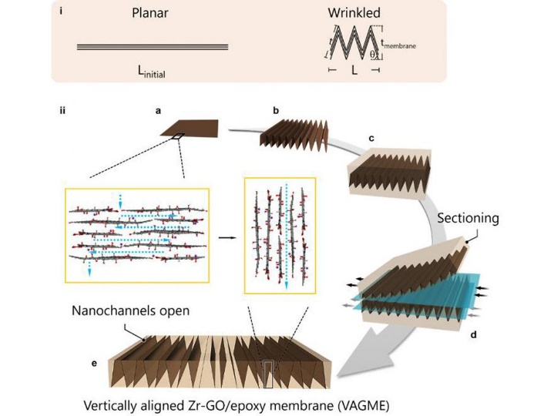
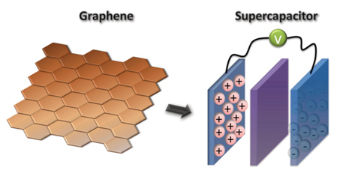
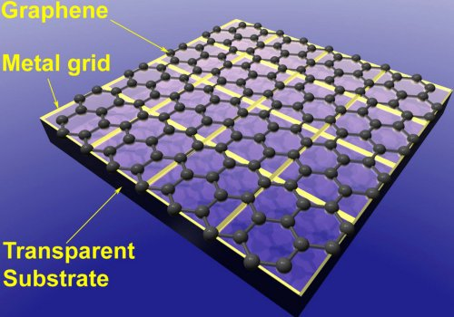
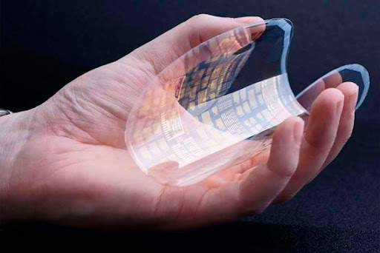
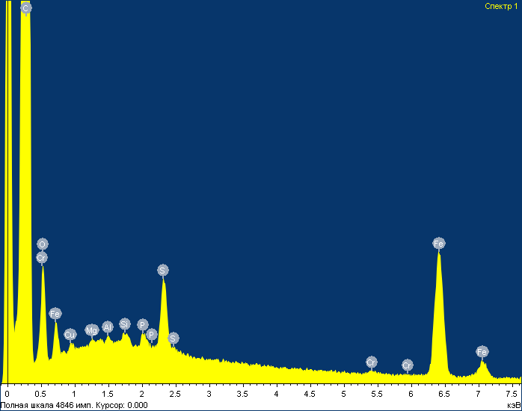
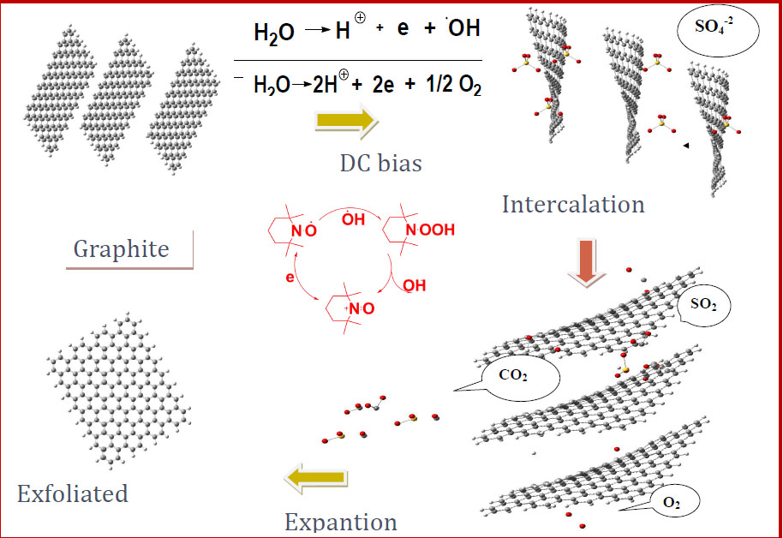
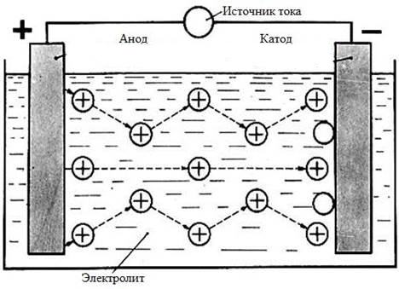
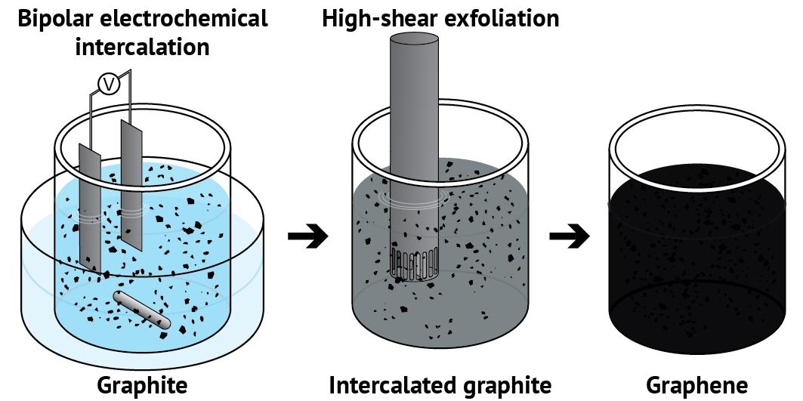
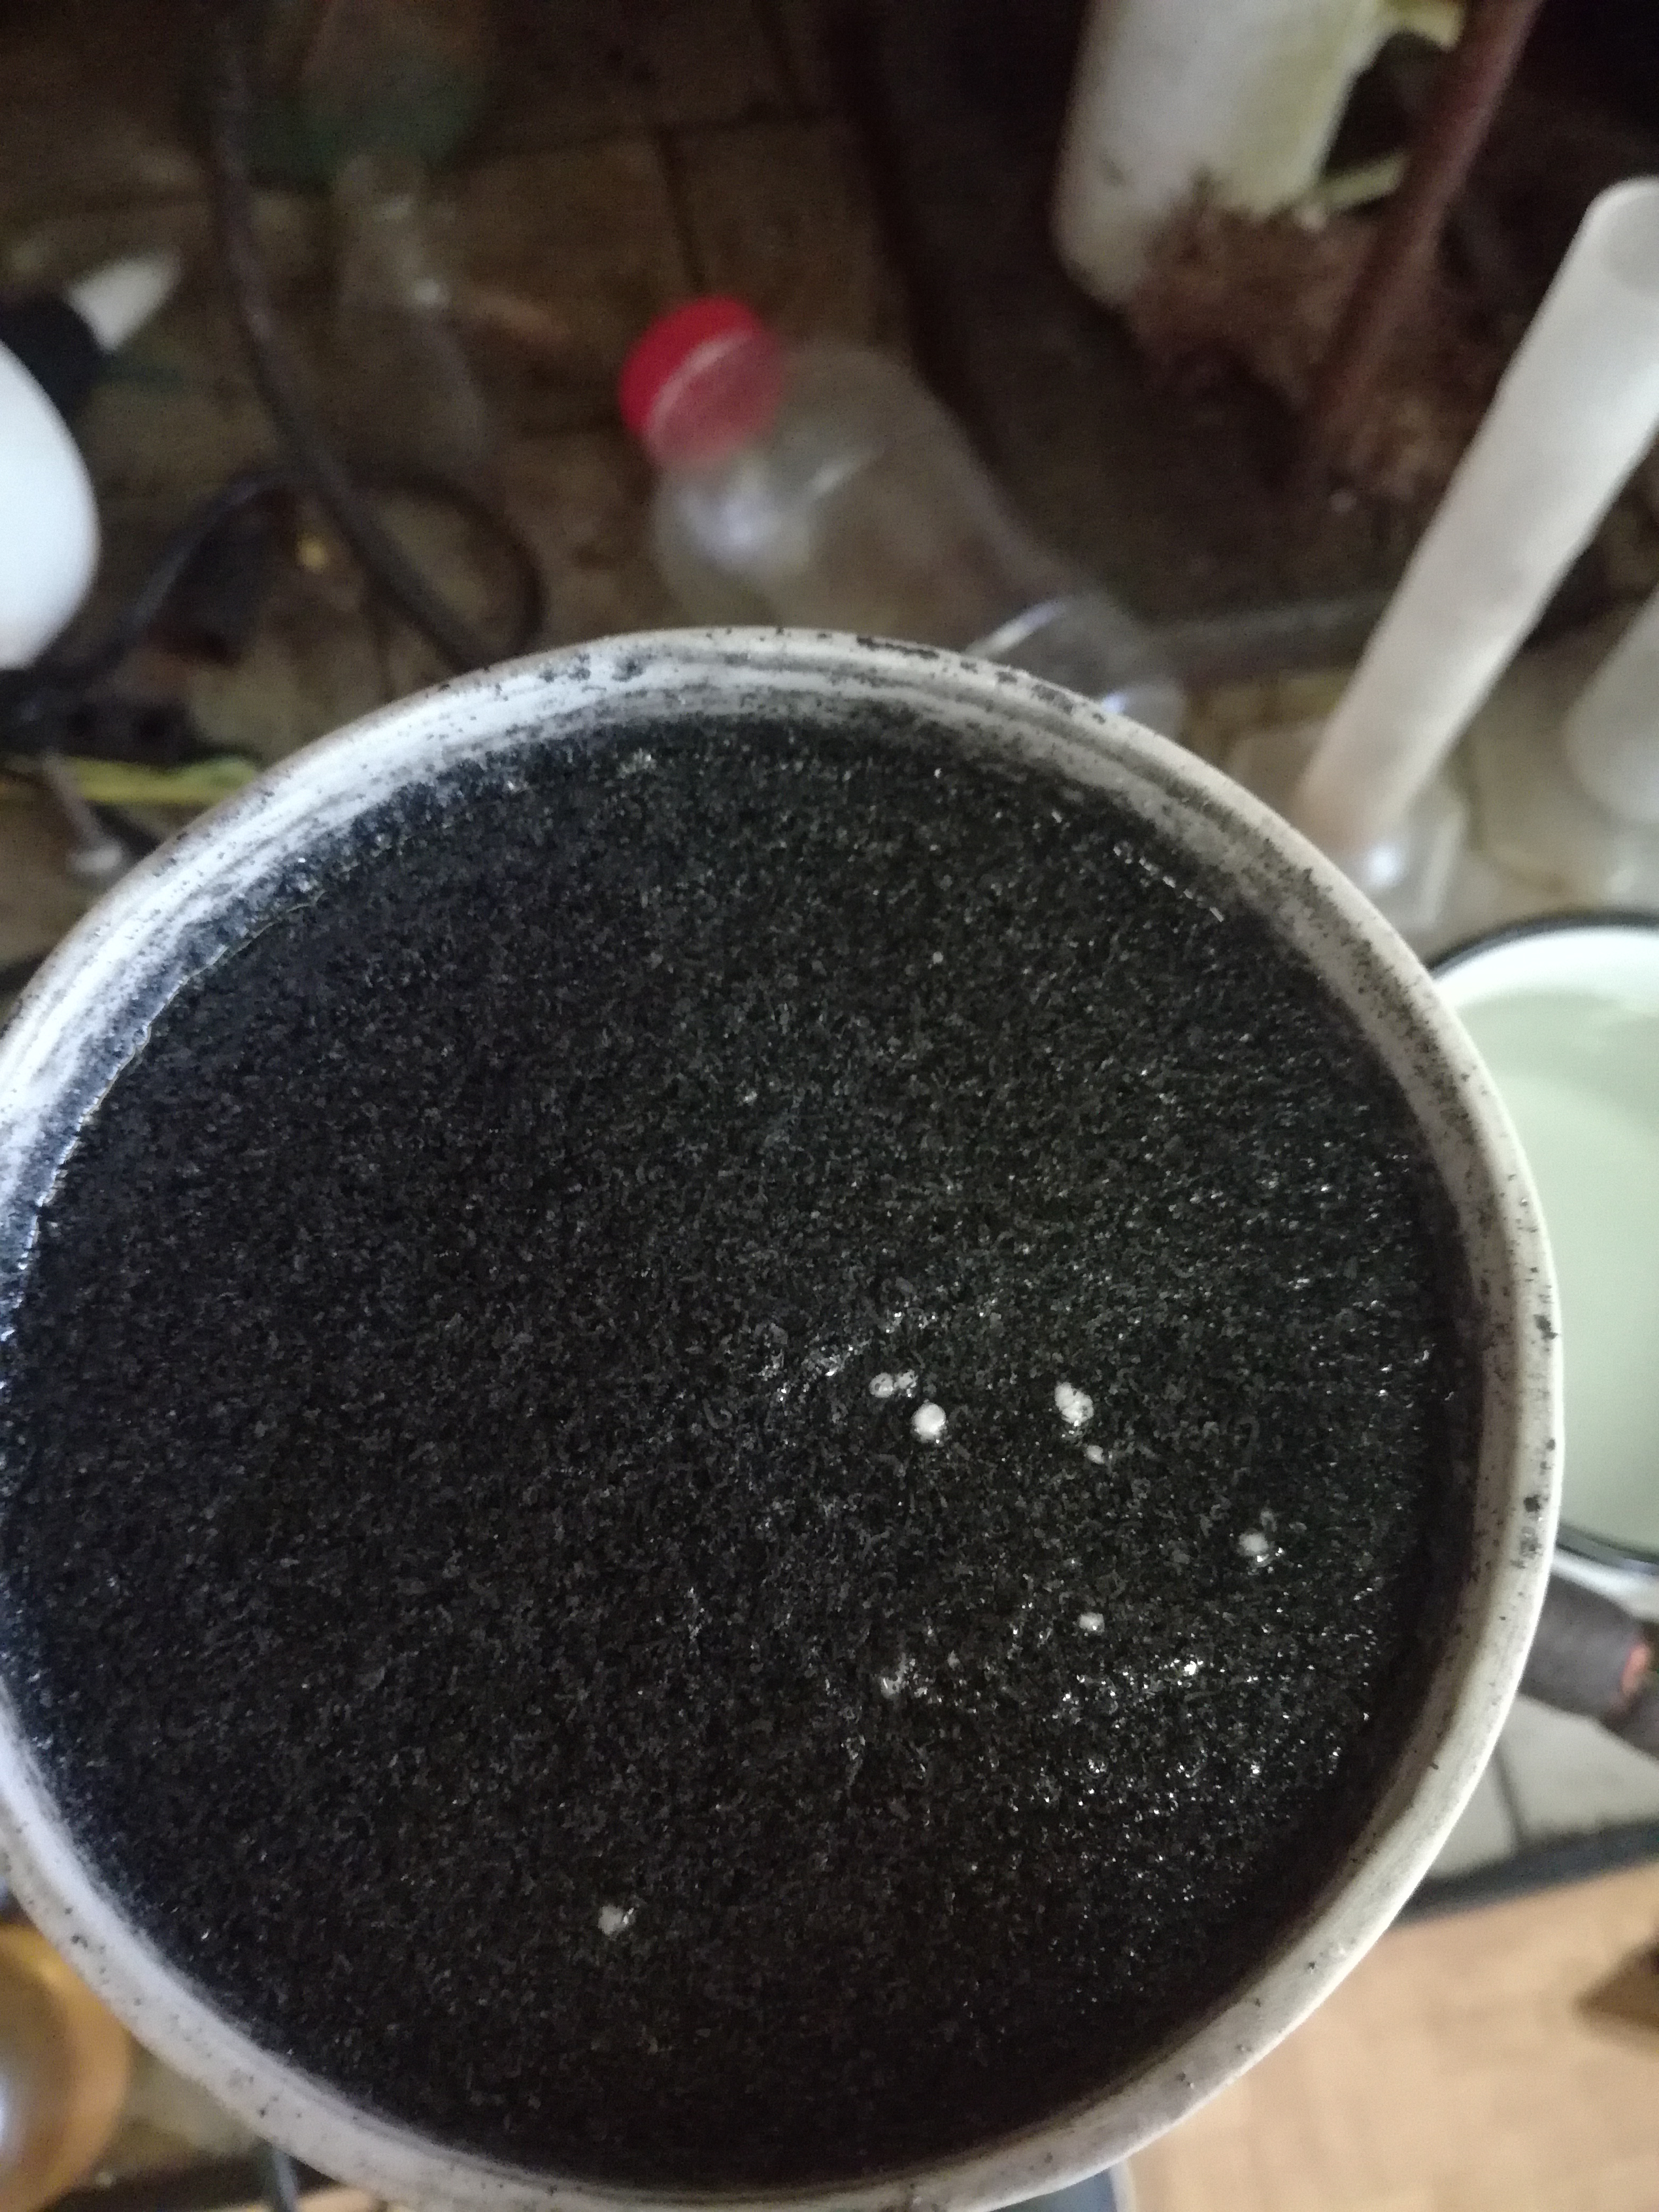
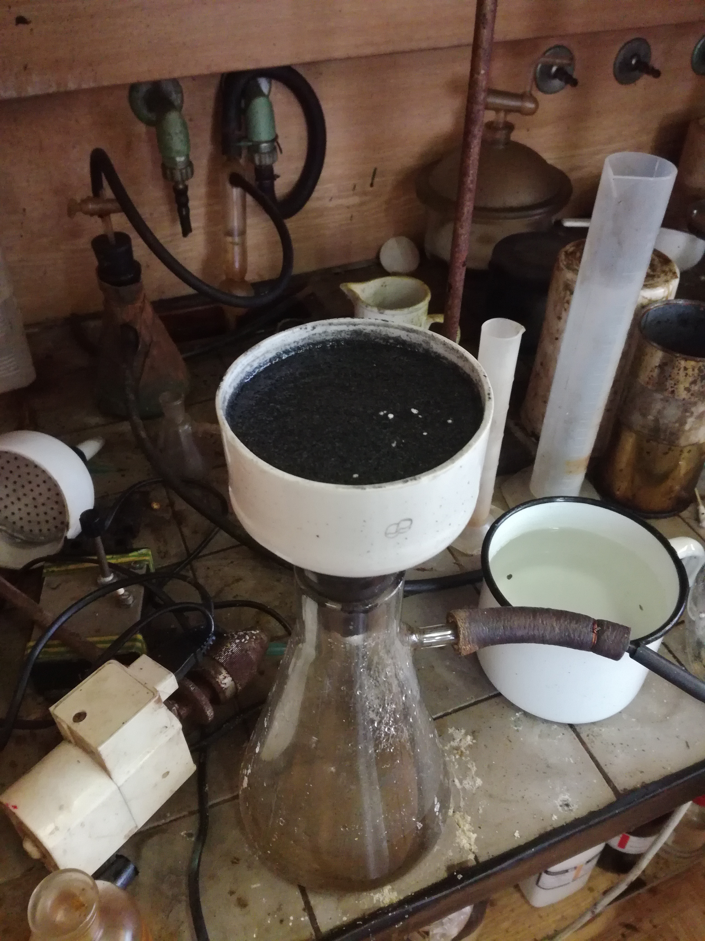
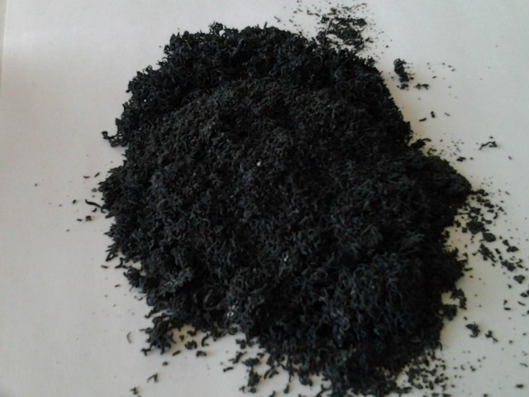
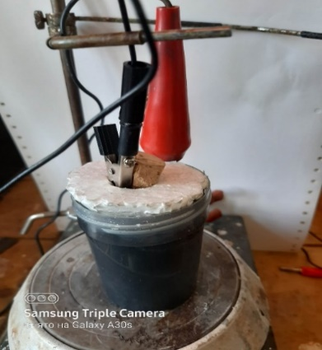
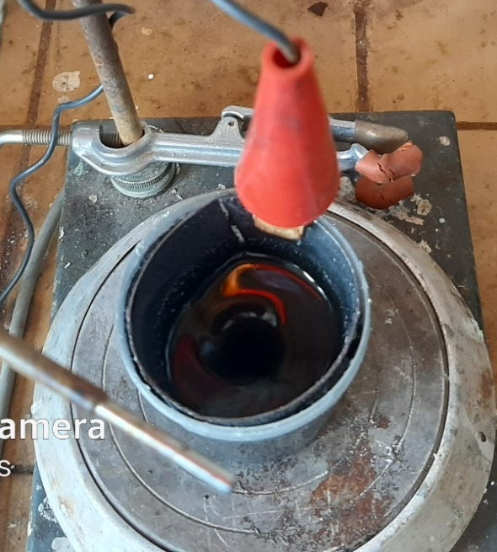
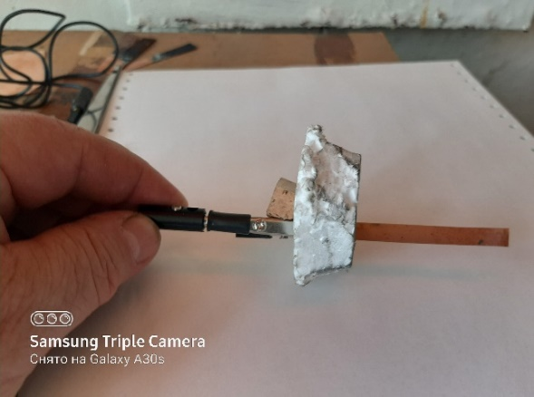
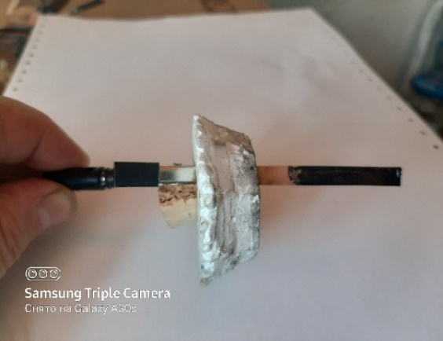
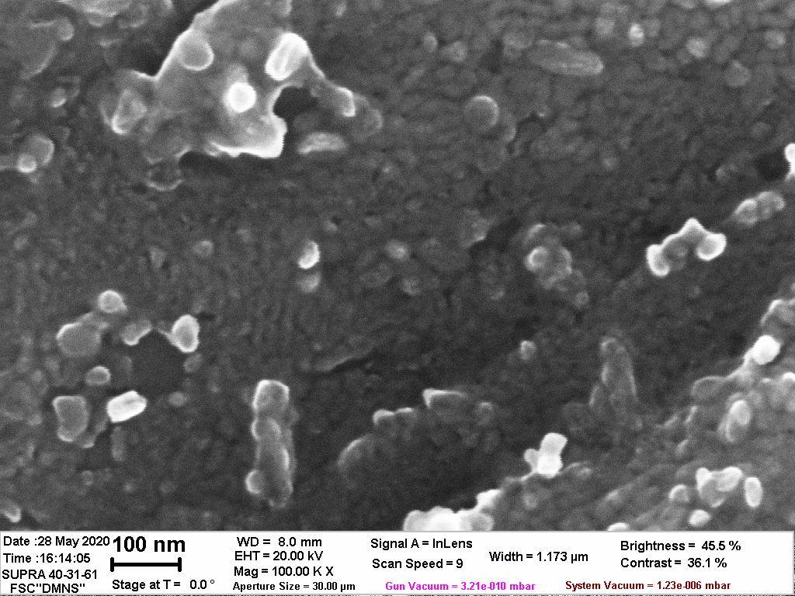
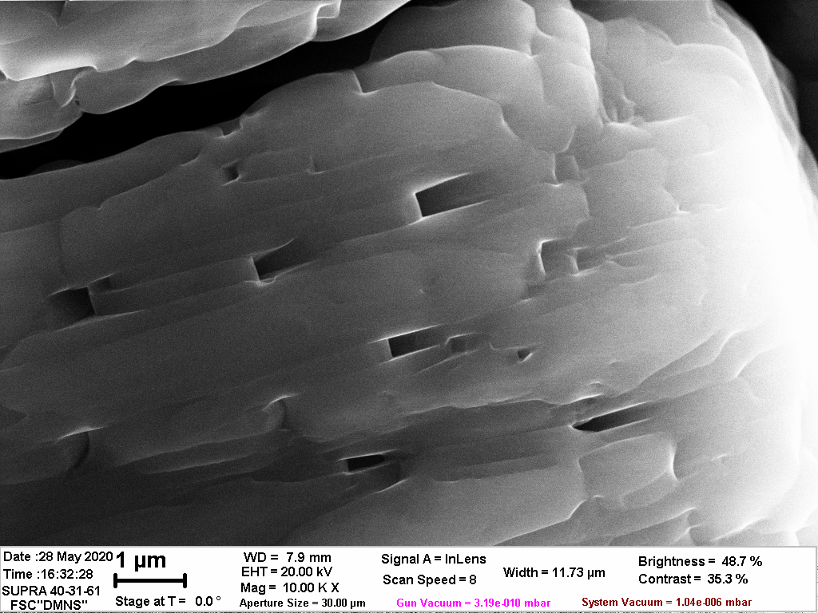
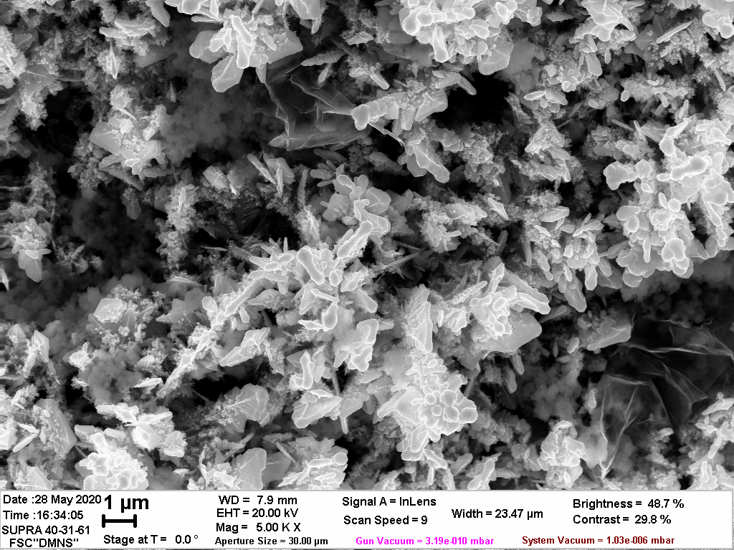
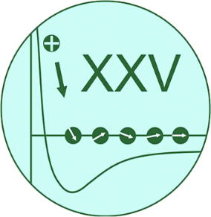





The investigation of electrophoretically deposited suspended graphene-based films by means of SEM, EDX/X-ray diffraction, and Raman spectroscopy measurements.
D.N.Savelyev ¹, E.A. Grushevski¹, N.G. Savinski², M. A. Smirnova¹, L.A. Mazaletsky², V.I. Bachurin² A.B. Churilov²
1 Base Department of Nanotechnology in Electronics, YarSU named after P.G. Demidov, st. Sovetskaya 14, Yaroslavl, Russia
2 Valiev Institute of Physics and Technology of Russian Academy of Sciences, Yaroslavl Branch st. Universitetskaya 21, Yaroslavl, Russia, dmitriy.savelev9@mail.ru
The electrophoretic deposition method is an attractive strategy for the production of structured graphene-like films for a wide range of applications, for example, solar cells, energy storage devices, field emission devices, bio-electrochemical sensors, electromagnetic interference protection, anti-glare and corrosion-resistant coatings , biomedical implants, drug delivery and tissue engineering. It has many advantages in the manufacture of graphene coating, such as high deposition rate and controlled layer thickness, outstanding uniformity, fewer restrictions on the material or geometry of the substrate, low cost and ease of scaling. However, initially graphene flake is hydrophobic, it is difficult to disperse in solution and, even worse, it is not inherently charged; therefore, the deposition of graphene coatings by the electrophoretic method is still a difficult task.
Fig. 1. graphen-based nanofilters
Fig. 2. Graphene-based supercapacitors
Fig. 3. Flexible transparent conductive coatings and films based on graphene
Fig. 6. EDX/X-ray diffraction spectrum of the elemental composition of 1 sample.
Atomic % of carbon – 93,04
Atomic % of oxygen – 5,68
Graphite exfoliation was carried out in a two-electrode cell, in an aqueous 3M solution of ammonium sulfate, graphite foil "graflex" was used as the anode, and platinum wire was used as the cathode. After exfoliation, the resulting sample was washed through a filter with deionized water. Then the sample was divided into 3 fractions according to the following process schemes.
Sample 1 is a filtered precipitate of exfoliated graphite dispersed in deionized water in the presence of a surfactant "Synthanol 23E4P5", using a rotary pulse device (cavitation effect) for 5 hours. After classification in a centrifuge at 1500 rpm, for 10 minutes. a large settled fraction was selected and dried in a cabinet at 50 oC for 24 hours.
Sample 2 The filtrate of sample 1 after the classification stage is centrifuged at 5000 rpm for 20 minutes, dried in a cabinet at 50 ° C for 24 hours.
Sample 3 The filtrate of sample 1 was subjected to Ultra-Sound processing (20 kHz. 60 W) for 8 hours. The precipitate was separated by centrifugation of 7000 rpm for 25 minutes, followed by drying in a 500C drying cabinet for 24 hours.
Graphite suspension for electrophoretic deposition of graphene-like films has the composition: filtrate of sample 3 with a carbon material content of 11 g/l and 5 % ammonium sulfate. Electrophoretic deposition is carried out in a neutral medium (pH=6.7) in the field strength range from 1.9 to 2.5 V / cm in a two-electrode system, deposition is performed on a copper cathode, the anode is a graphite foil. Studies of the film structure were carried out using an EnSpectr R532 raman spectrometer, a Zeiss SUPRA – 40 electron microscope with an INCA Energy Oxford Instruments X-ray energy dispersion analyzer, and an ARL XTRA Termo Techno powder X-ray diffractometer
Fig. 4. Schematic process of electrochemical exfoliation of graphite
Fig. 7. Scheme of the electrophoretic deposition method
Fig. 5. Nanographene formation, filtration and powder production
Table 1. Characteristics of Raman spectra of samples.
Fig. 8. Workflow
№ Sample | D | G | 2D | I_{D}/I_{G} | I_{2D}/I_{G} | L_{A} nm | n_{D} mcm⁻² | n_{D} /n_{C} (ppm)
1(I) | 123,5 | 773,0 | 146,2 | 0,160 | 0,189 | 34,6 | 766 | 129
1(A) | 3051,0 | 20332,0 | 8050,0 | 0,150 | 0,396 | 35,8 | 520 | 136
2(I) | 278,0 | 1073,0 | 67,0 | 0,259 | 0,062 | 27,2 | 431 | 115
2(A) | 8523,0 | 29808,0 | 1888,0 | 0,286 | 0,063 | 25,9 | 476 | 125
3(I) | 278,0 | 1104,0 | 323,0 | 0,252 | 0,293 | 27,6 | 419 | 110
3(A) | 6862,0 | 30510,0 | 22162,0 | 0,225 | 0,726 | 29,2 | 374 | 98
film (I)* | 36,33 | 24,14 | 74,26 | 0,250 | 3,07 | 27,7 | 415 | 109
film(A)* | 309 | 2172 | 3158 | 0,14 | 1,45 | 37,0 | 233 | 61
To estimate the number of atomic layers of a graphene-like material flake, a method based on the analysis of X-ray diffraction was used. Processing of the obtained results showed that the size of the crystallites for the first three samples is 12 ± 3 nm and practically does not depend on the processing conditions of the material. This is probably due to the conditions of the analysis, since exfoliated graphite particles tend to aggregate and stack on top of each other after drying on the surface of the Si/SiO2 substrate and the copper mesh when they are used for SEM and TEM observation, which leads to different thickness values obtained using SEM/TEM and AFM imaging.Raman spectroscopy (RAMAN) is a powerful tool for studying carbon structures.
$$L_{A}^{2}\left(nm\right)=\left(2.4×{10}^{−9}\right){λ_{Laser}^{4}\left(\frac{I_{D}}{I_{G}}\right)}^{−1}$$
$$n_{D }\left({см}^{2}\right)= {{10}^{14}}/{\left(πL_{D}^{2}\right)}$$
These equations 1 and 2 are obtained to determine the size of the crystal regions of graphene L_{a} and the density of defects, or in other words, the distance between the defects of the graphene crystal lattice depending on the energy of the exciting radiation used in the visible range, where laser excitation is used in terms of either E_{laser} eV, or wavelength in nm. For a laser with a wavelength of 532 nm, the defect density nD can be represented by equation 2. For a cellular ideal lattice, the number of carbon atoms is n_{c} = 3.82 x 10⁷ (mcm⁻²), if we normalize the number of defects in equation 2 by n_{c} , we can get the concentration of defects per mcm⁻² in millionths (ppm).
Table 1 shows the results of processing the Raman spectra of samples.
The relatively low value of the integral intensity ratio I_{D}/I_{G} indicates a low defect rate of the process.
is the intensity of the band, (A) is the integral area of the band
*The film formed by electrophoretic deposition
In this method, a positively charged multigraphene particle is deposited on the cathode (cataphoresis). A partial positive charge on a nanographene particle can be formed due to neutralization by NH4+ electrolyte ions of partially oxidized nanographene having a carbonyl anion on the surface. Figure 9 shows the process of electrophoresis in the framework of the Hamaker model.In general, the process of deposition of nanographene by electrophoresis proceeds according to a linear law in time. When the graphite concentration in the suspension is 11 g/l, this linear dependence is maintained for approximately 300-500 seconds of the process, then the process graph goes to saturation and goes at a lower speed.
This behavior is typical for electrophoresis and can be described within the framework of the Hamaker model.
$$\frac{\text{dW}}{\text{dt}}\text{=} \text{f} \text{μ} \text{EA}{\text{C}}_{\text{s}}$$
Where: W is the deposited mass (kg),
t is the deposition time (s),
µ is the electrophoretic mobility (m²(B*s)⁻¹) ,
E is the applied potential (B*m ⁻ ¹),
A is the surface area of the electrode (m),
C_{S} is the concentration of particles in the colloid (Kg*m ⁻ ³),
and f is the efficiency coefficient.
The efficiency factor takes into account the proportion of particles that come into contact with the surface of the electrode and are subsequently deposited on metal substrates.
Fig. 9. Electrophoretic deposition of nanographene on a copper cathode, from a solution of 3 mol ammonium sulfate electrolyte.(process at different voltage and current values )
Fig.10. Deposition of 15 seconds
Fig.11. Deposition of 30 seconds
Fig.12. Deposition of 800 seconds
Conclusion
The process of electrophoretic precipitation from an aqueoussolution of an electrolyte of ammonium sulfate is carried out. At the initial stage of growth (up to 15 seconds), the growth of a layer of small individual nanographene particles less than 100 nm in diameter is noticeable. Then a layered structure is formed (30 seconds of deposition) with a layer size of about 300 nm and up to several microns. Finally, at a growth time of 800 seconds, columnar structures with a developed relief begin to form. The process is characterized as low-defect.

