Slide 1

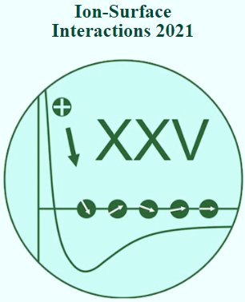
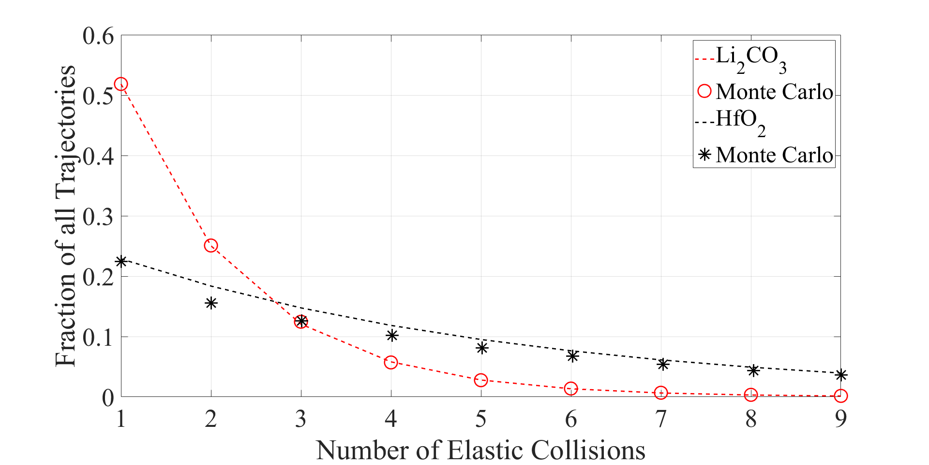
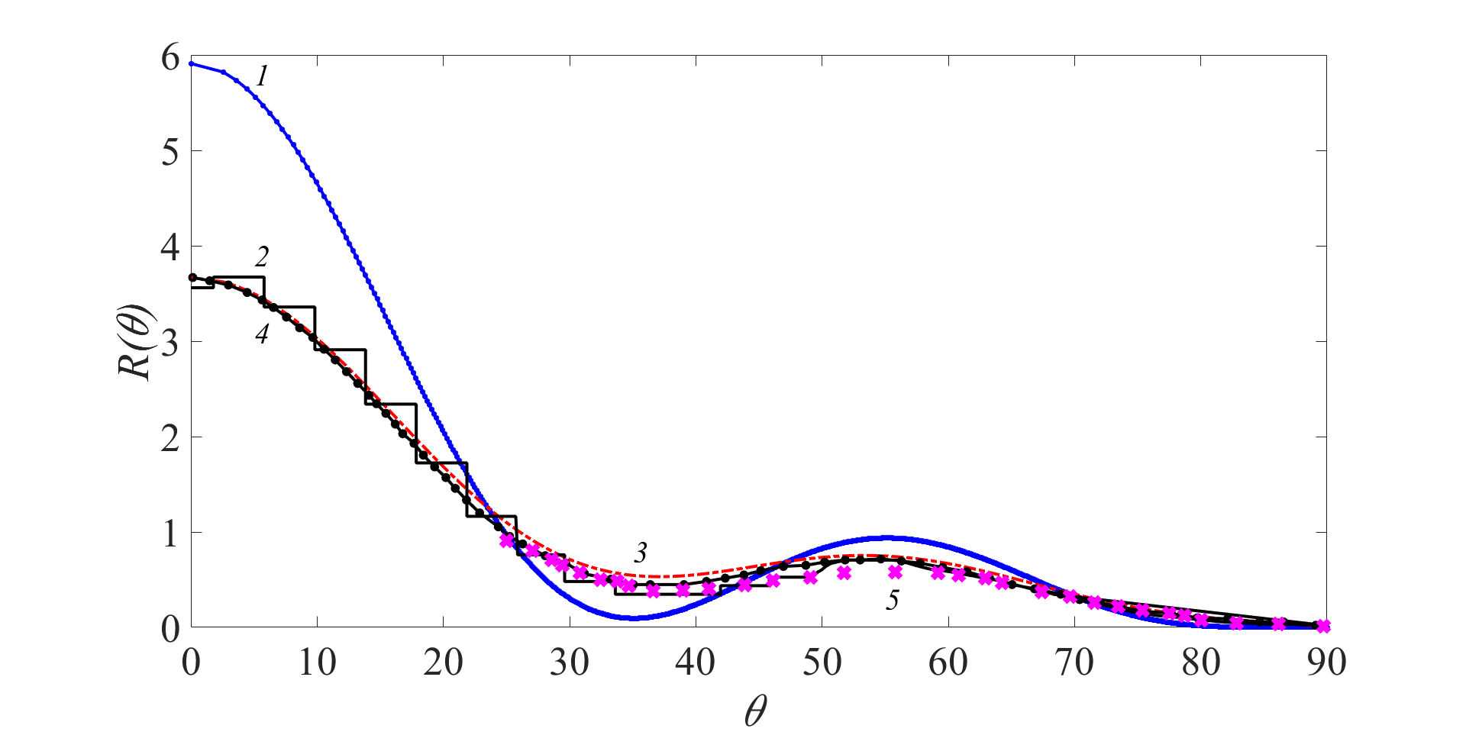
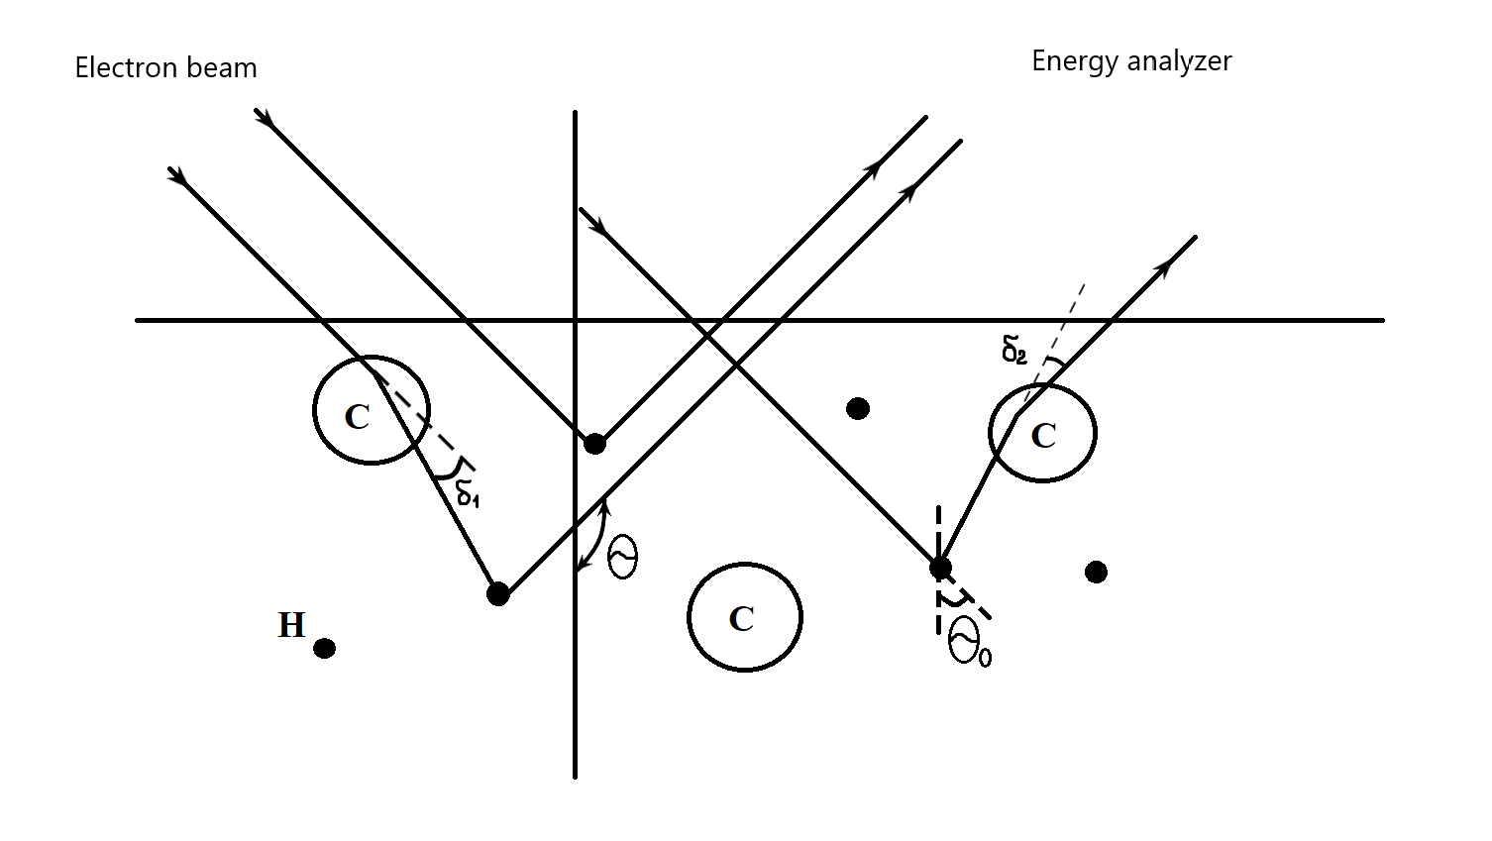
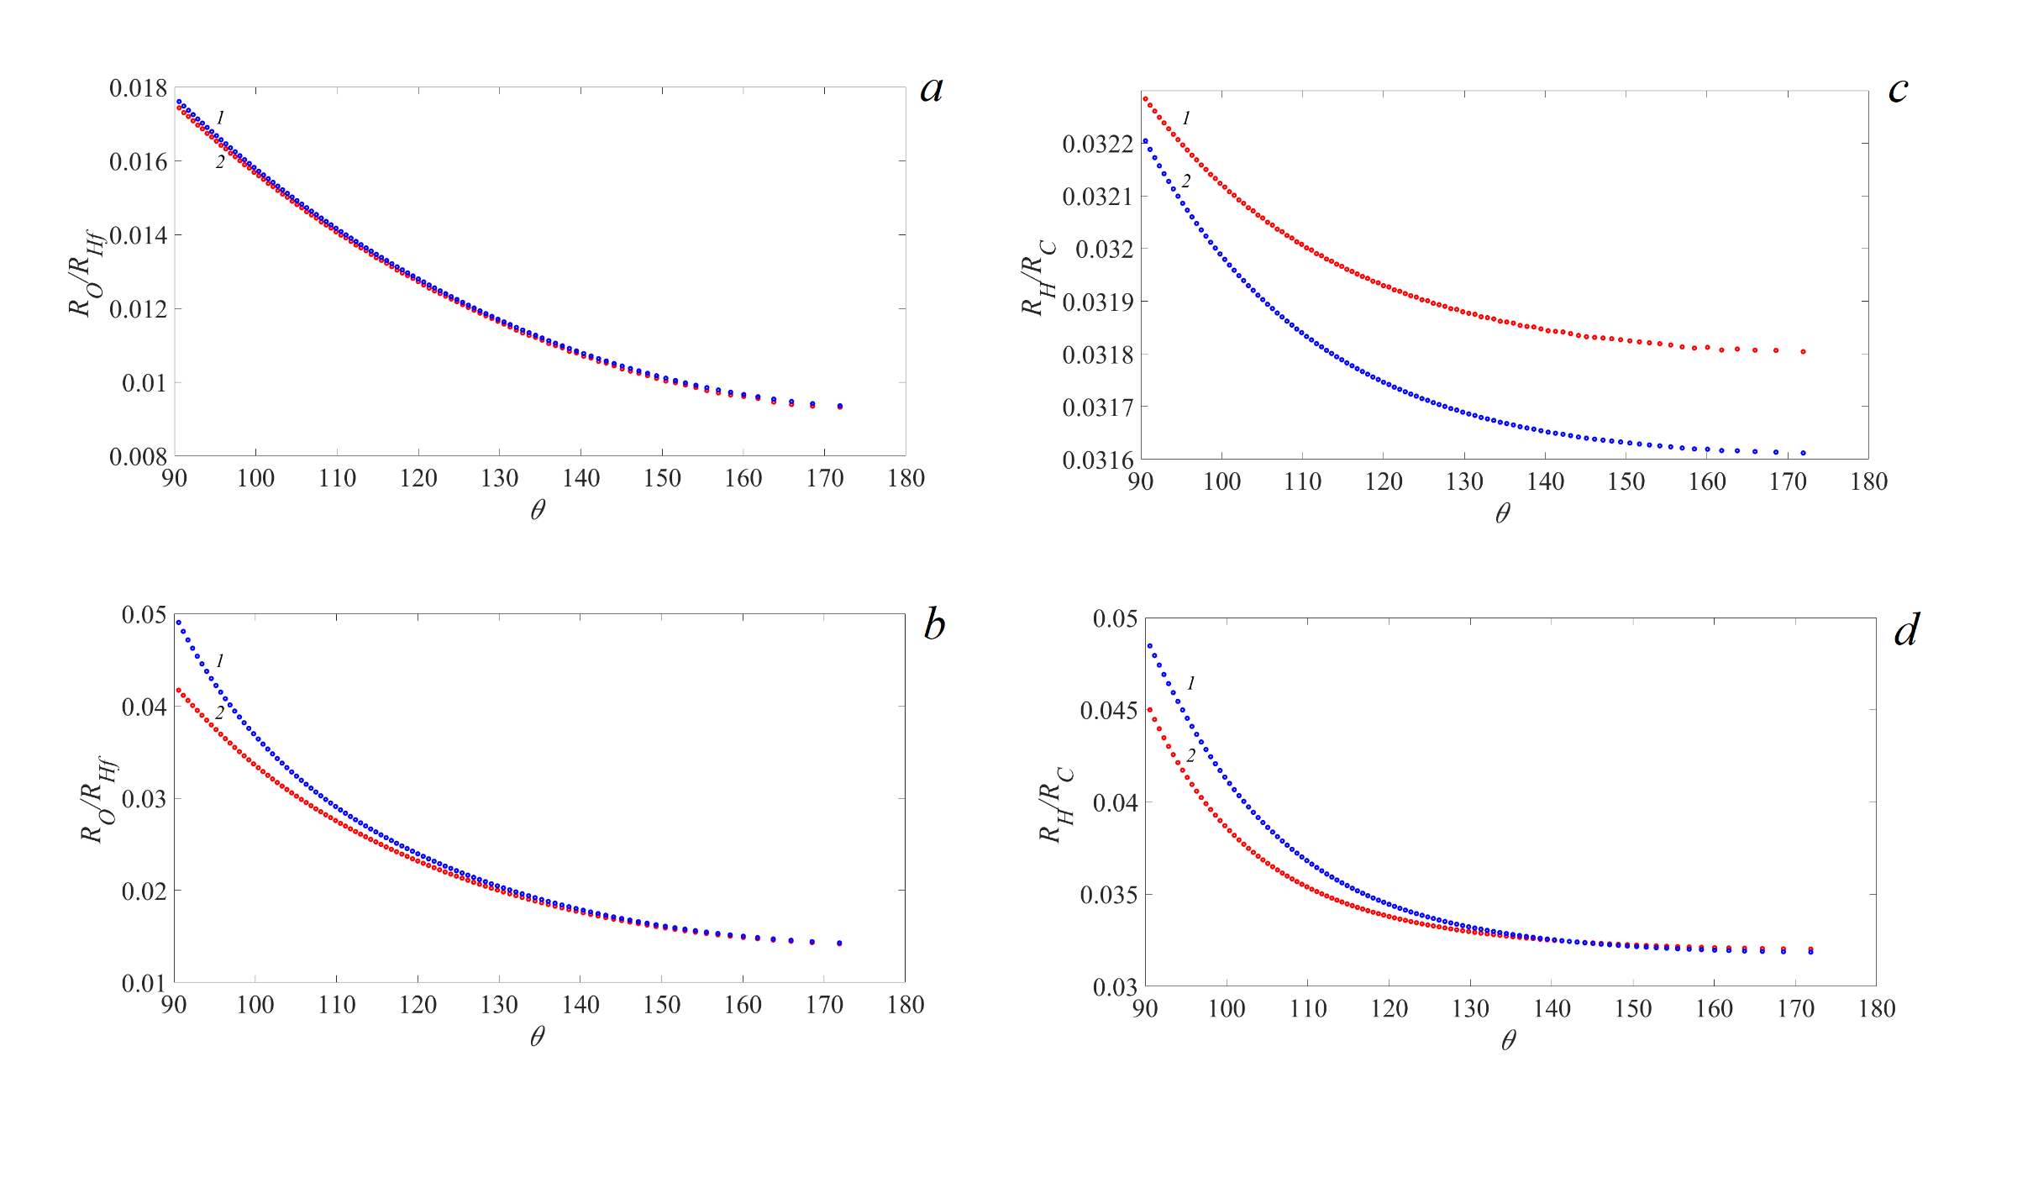
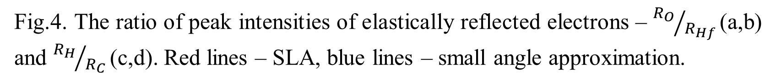
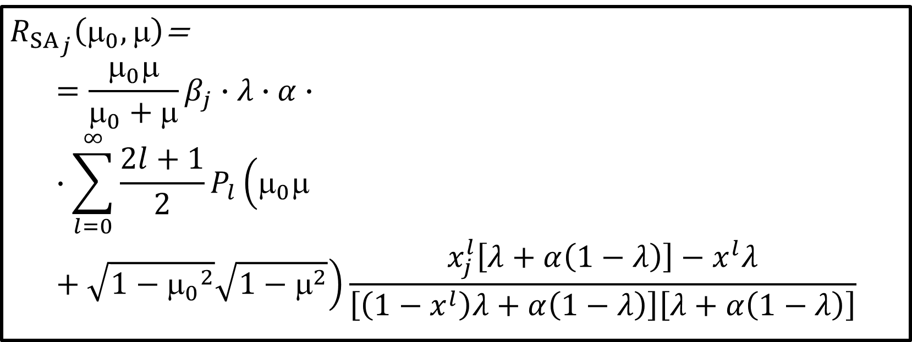
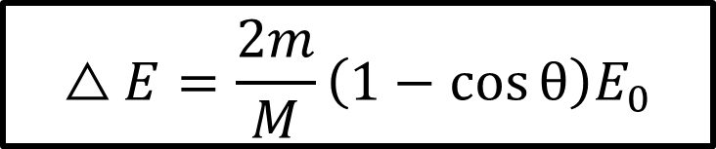
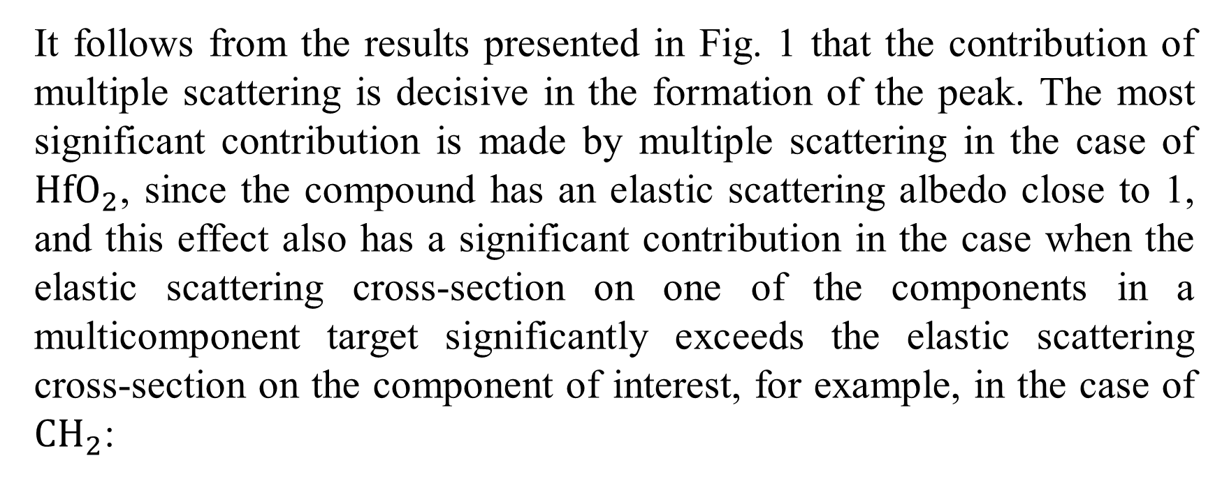

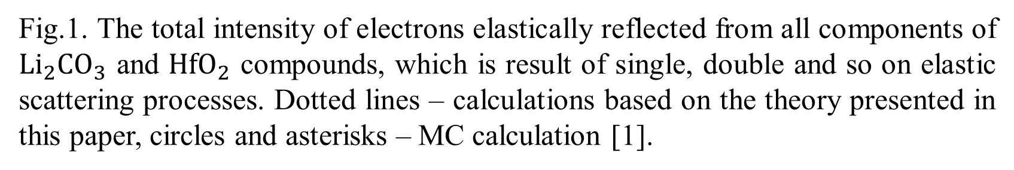
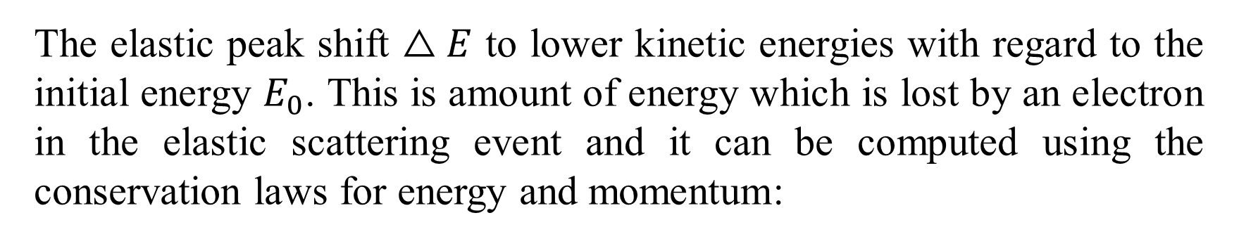
THE EFFECT OF MULTIPLE SCATTERING ON THE ACCURACY OF DETERMINING THE CONCENTRATION OF HYDROGEN ISOTOPES USING epeS
V.P. Afanas’ev¹, L.G. Lobanova¹
¹ National Research University "Moscow Power Engineering Institute“, Moscow, Russia e-mail: vaf@vaf.su
$${R_{SLA}}_{j}\left(_{0},\right)=\frac{_{0}}{_{0}+}\frac{β_{j}∙λ∙x_{j}\left(_{0},\right)}{1−λ}$$
(2)
${R_{SA}}_{j}\left(μ_{0},μ\right)$=
$$=\frac{_{0}}{_{0}+}β_{j}∙λ∙α∙∙\sum_{l=0}^{∞}{\frac{2l+1}{2}P_{l}\left(_{0}+\sqrt{1−{_{0}}^{2}}\sqrt{1−^{2}}\right)\frac{x_{j}^{l}\left[λ+α\left(1−λ\right)\right]−x^{l}λ}{\left[\left(1−x^{l}\right)λ+α\left(1−λ\right)\right]\left[λ+α\left(1−λ\right)\right]}}$$
(3)
Fig.1. The total intensity of electrons elastically reflected from all components of ${Li}_{2}CO_{3}$ and ${HfO}_{2}$ compounds, which is result of single, double and so on elastic scattering processes. Dotted lines – calculations based on the theory presented in this paper, circles and asterisks – MC calculation [1].
It follows from the results presented in Fig. 1 that the contribution of multiple scattering is decisive in the formation of the peak. The most significant contribution is made by multiple scattering in the case of ${HfO}_{2}$, since the compound has an elastic scattering albedo close to 1, and this effect also has a significant contribution in the case when the elastic scattering cross-section on one of the components in a multicomponent target significantly exceeds the elastic scattering cross-section on the component of interest, for example, in the case of ${CH}_{2}$:
Fig.3. Angular distribution of elastically reflected electrons from gold, «normal» geometry. 1 – SLA approximation (2), 2 – Monte Carlo [2], 3 – modified small angle approximation (3), 4 – calculation based on the method of discrete ordinates (MDOM) [2], 5 – experiment.
Fig.2. Schema of the processes of single and double elastic scattering processes leading to the formation of a peak of electrons elastically reflected from protons. Elastic scattering cross section of carbon (circle) and hydrogen (black dot) are schematically presented.
The elastic peak shift $△E$ to lower kinetic energies with regard to the initial energy $E_{0}$. This is amount of energy which is lost by an electron in the elastic scattering event and it can be computed using the conservation laws for energy and momentum:
Fig.4. The ratio of peak intensities of elastically reflected electrons – ${R_{O}}/{R_{Hf} }$(a,b) and ${R_{H}}/{R_{C} }$(c,d). Red lines – SLA, blue lines – small angle approximation.
Conclusions
The determining effect of multiple elastic scattering on the intensity of the peak of elastically reflected electrons is shown. The inconsistency of the OKG model for calculating the peak intensities of individual components of a target of complex composition is shown.
The paper establishes the fact of a satisfactory description of the angular distributions of elastically reflected electrons in the approximation of rectilinear trajectories – SLA.
$$△E=\frac{2m}{M}\left(1−\cos{θ}\right)E_{0}$$
(1)
[1] Vos M. Marmitt G.G., Grande P.L.//Surface and Interface Analysis, 48(7)(2016) 415. DOI 10. 1002/sia.5489
[2] V.Р. Afanas'ev, D.S. Efremenko and A.V. Lubenchenko On the application of the invariant embedding method and the radiative transfer equation codes for surface state analysis // Light Scattering Reviews 8 (2013) P. 363-423
Fig.2. Area ratios under peaks calculated in the single scattering approximation:

